Slide 1

Visualization Catalogue
Catalogue is taken from:
“Nancy Duarte, Slide:ology”
https://www.duarte.com/resources/books/slideology/
Examples are taken from real-world ALTANA presentations (incl. consultancies)
Gerne weitere “best-ofs” hinzufügen !!

Slide 2
Abstract concepts 1/2
  Flow
    Linear: Flow construction that illustrates a process with a definite start and end point. The diagram can follow a straight line or be a series of steps along a line
    Circular: Flow that represents a continuous process with out an end point. Any closed loop shape could work
    Divergent and convergent: Flow that occurs when two or more elements either collide or separate out from each as if splitting off.
    Multidirectional: Flow that expresses complex relation ships – flow charts, for instance. Often these flows result from a combination of the preceding types
  Structure
    Matrices: Structures that compare data with at least two different data sets. One set can even be a yes/no set of data, as in a checklist.
    Trees: Structures that indicate clear hierarchy. Relationships can be expressed between any number of objects.
    Layers: Structures that show elements that stack or build on each other. They can depict both hierarchy and sequence.
Flow
Structure
Linear
Circular
Divergent
Convergent
Multidirectional
Matrices
Trees
Layers

Slide 3
Abstract concepts 2/2
Cluster
Radiate
Overlapping
Closure
Enclosed
Linked
From a point
With a core
Without a core
  Cluster
    Overlapping: Clusters that overlap and indicate shared sets, interest or responsibility. Sometimes they form a new shape or area withing the overlap.
    Closure: Clusters that emerge when shapes combine to create another shape. The principle of Gestalt psychology can be useful when expressing the idea that “the sum is greater than the parts”.
    Enclosed: Clusters that are enclosed and contain at least one element that envelops another. Grouping in this way indicates which elements are part of a higher order, and which stand alone.
    Linked: Clusters that are linked as a unifying element to group items. A unifying element links related groups of items. It could be a line, shape or connector of any kind
  Radiate
    From a point: Occurs when a single directional burst emerges from either a graphic or point that has a clear point of original.
    With a core: Creates a parent-child relationship. The outer elements connect with a central element to hold the family together.
    Without a core: Implies that elements connect through proximity or mutual attraction. They are tied to one central idea.

Slide 4
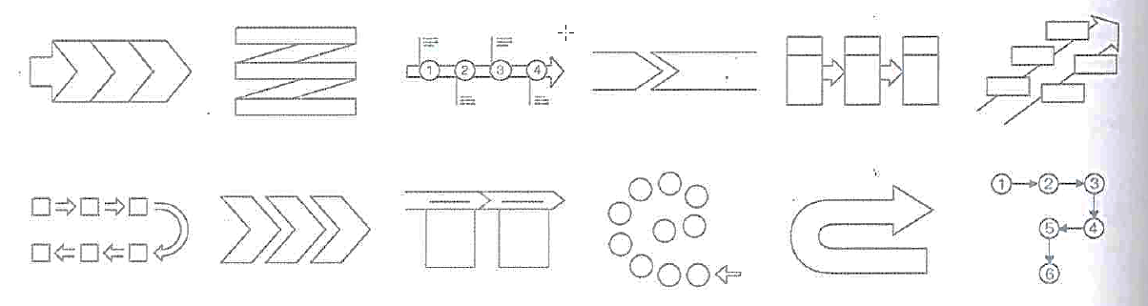
Abstract Concepts: Flow - linear
1
2
3
4
1
2
3
5
4
6

Slide 5
Abstract Concepts: Flow - linear

Slide 6
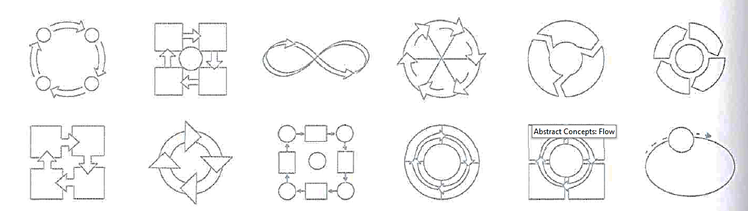
Abstract Concepts: Flow – circular

Slide 7
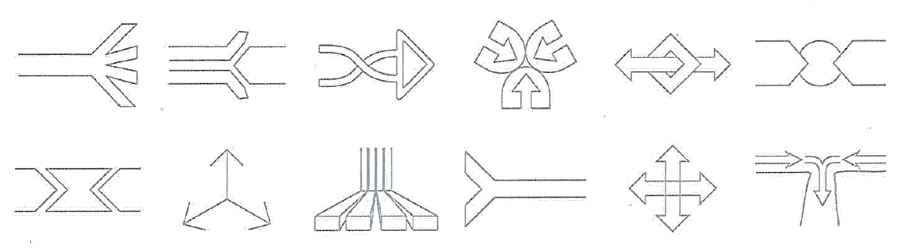
Abstract Concepts: Flow – Divergent & Convergent

Slide 8
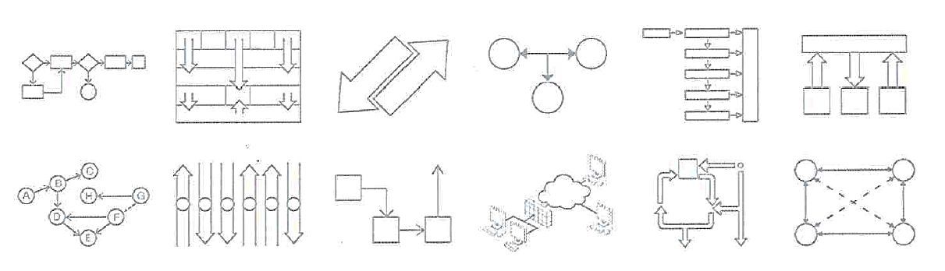
Abstract Concepts: Flow - multidirectional

Slide 9
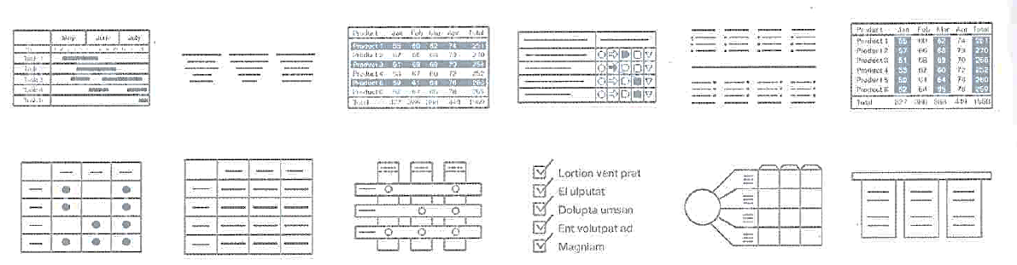
Abstract Concepts: Structure - Matrices

Slide 10
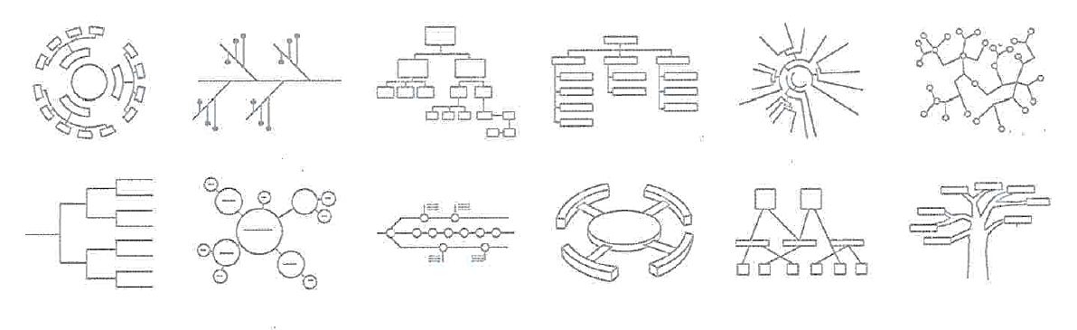
Abstract Concepts: Structure - Trees

Slide 11
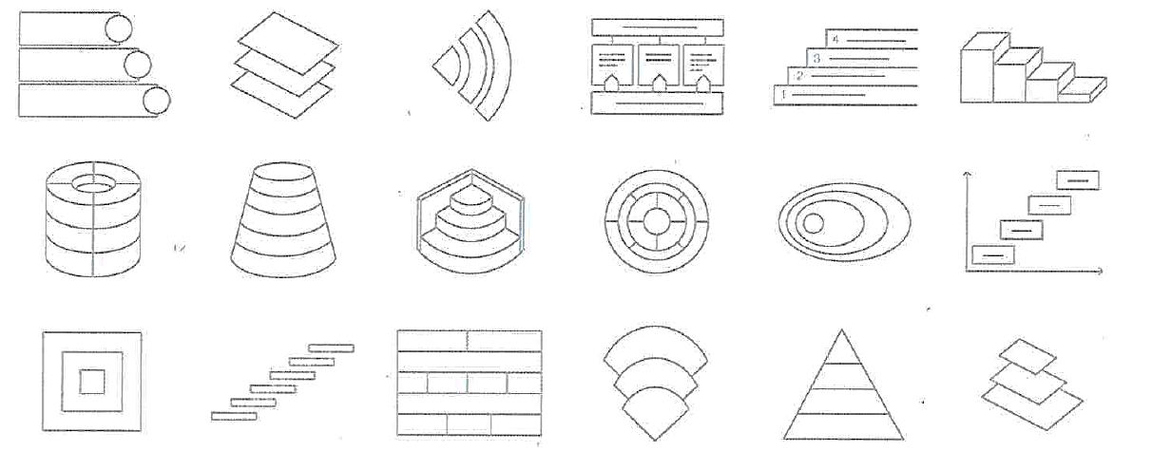
Abstract Concepts: Structure – Layers

Slide 12
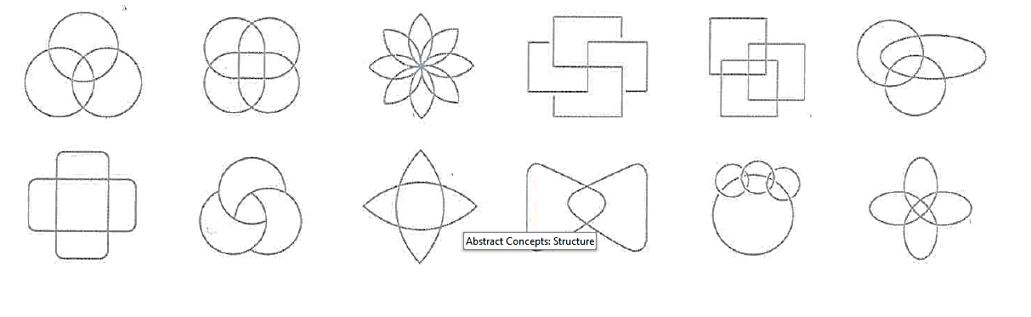
Abstract Concepts: Cluster - Overlapping

Slide 13
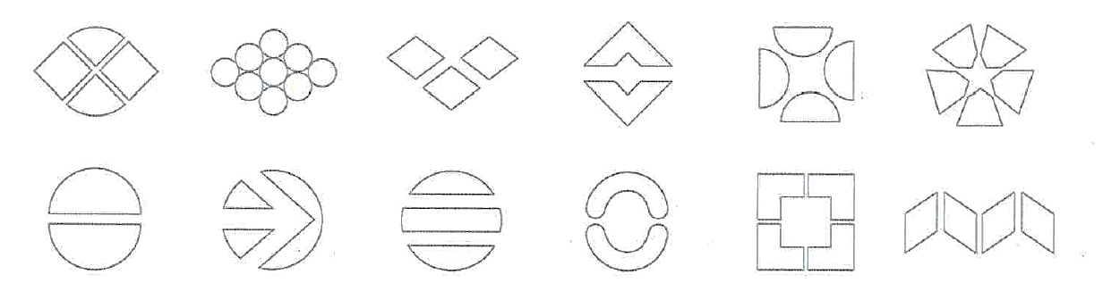
Abstract Concepts: Cluster - Closure

Slide 14
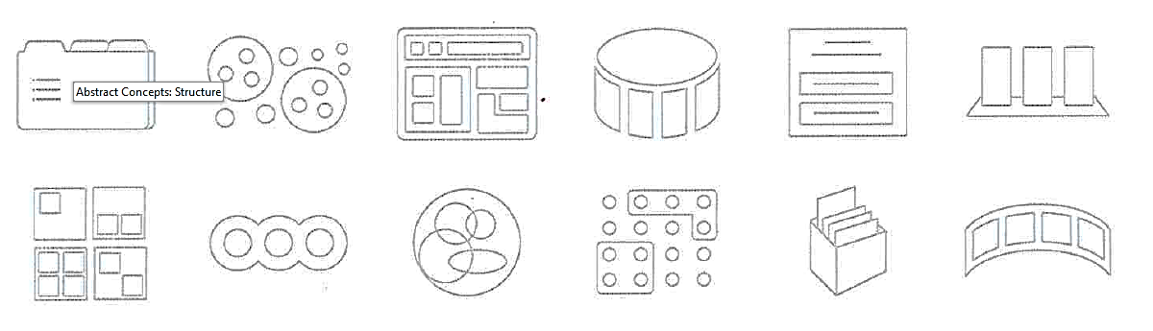
Abstract Concepts: Cluster - Enclosed

Slide 15
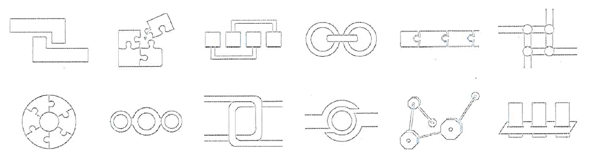
Abstract Concepts: Cluster - Linked

Slide 16
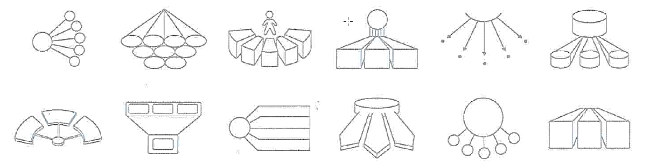
Abstract Concepts: Radiate – from a point

Slide 17
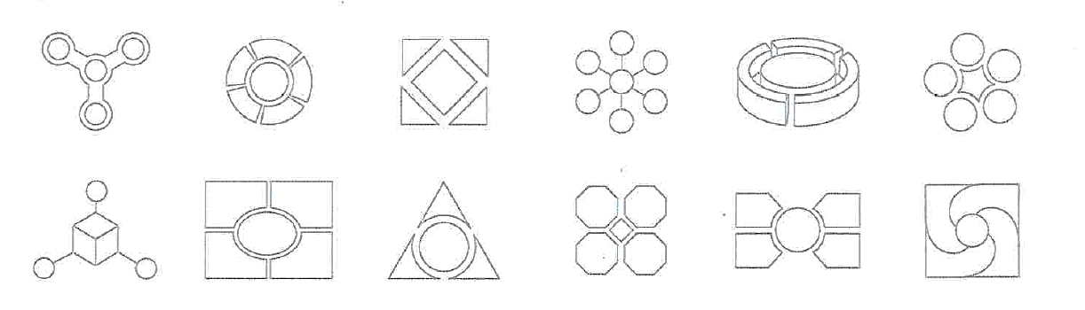
Abstract Concepts: Radiate – with a core

Slide 18
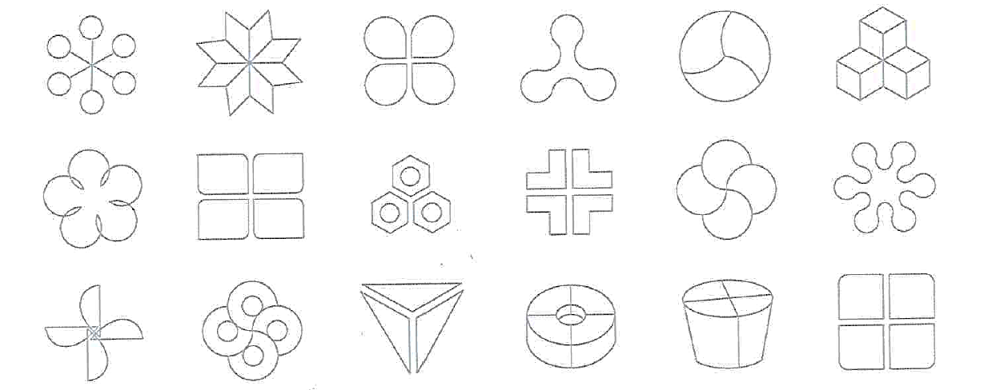
Abstract Concepts: Radiate – without a core

Slide 19
Realistic Concepts
Realistic Concepts
Pictorial
Reveal
Direction
Location
Influence
Display Data
Comparison
Trend
Distribution
Process
Process: A Snapshot of how things work sequentially as a product or system
Reveal: An illustration of hidden information shown by slicing, peeling, or otherwise exposing a thing’s inner workings
Direction: Showing where to go or how to get somewhere. They usually feature a starting location and a destination and may contain written directions.
Location: Showing where something is in the context of geography, topography, system, or shape. These diagrams call attention to a specific location while providing context.
Influence: Demonstrating the resulting impact of various interacting elements.
Comparison: Juxtaposition of two or more sets of information to illustrate differences. Bar graphics, pie charts, and any number of other methods are suitable.
Trend: One parameter of the data represents time, to indicate a trend. Change over time is the most important aspect of these diagrams.
Distribution: Expression of a pattern in seemingly disparate data. Whether a scatter plot, bell curve, or other model, distribution diagrams correlate singular instances into a larger pattern.

Slide 20
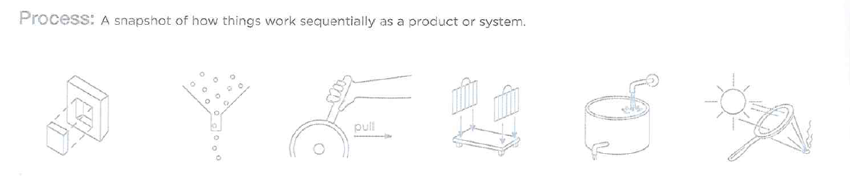
Realistic Concepts

Slide 21
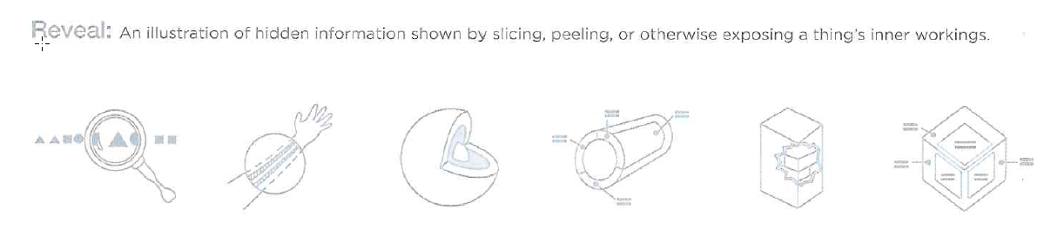
Realistic Concepts

Slide 22
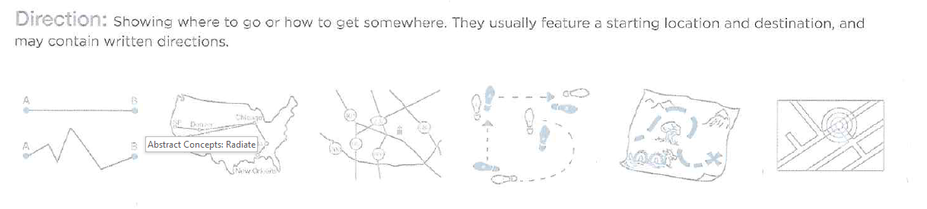
Realistic Concepts

Slide 23
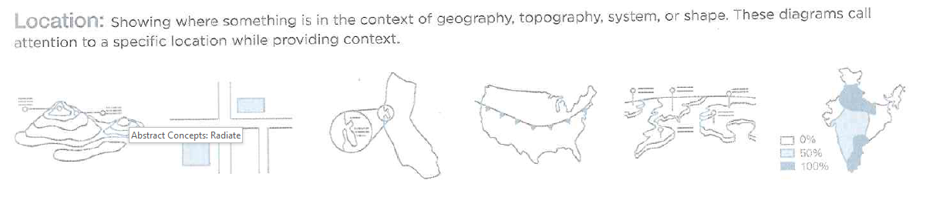
Realistic Concepts

Slide 24
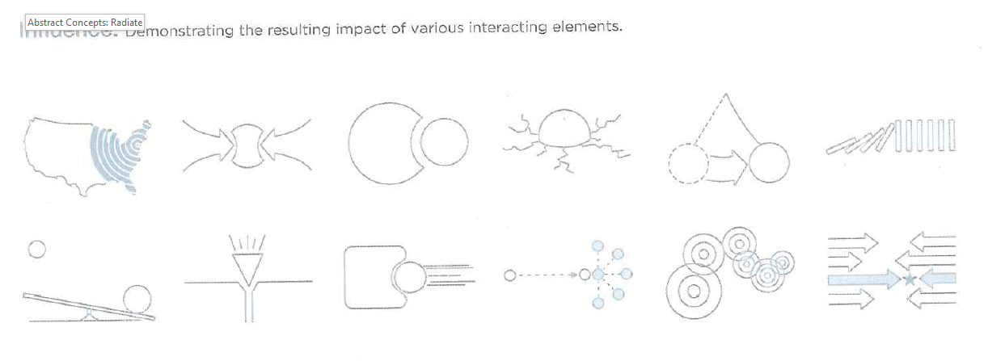
Realistic Concepts

Slide 25
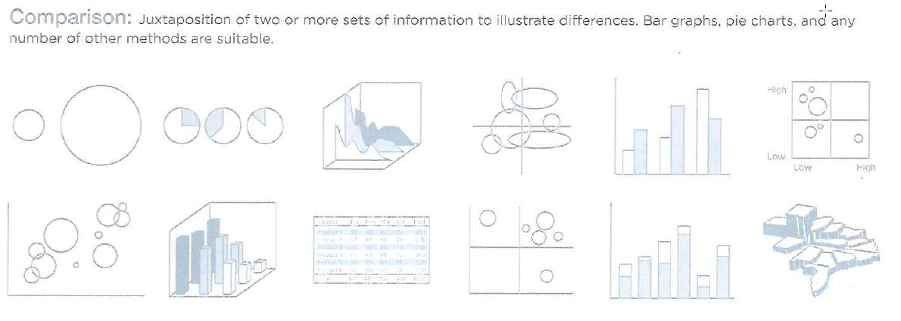
Realistic Concepts: Display Data

Slide 26
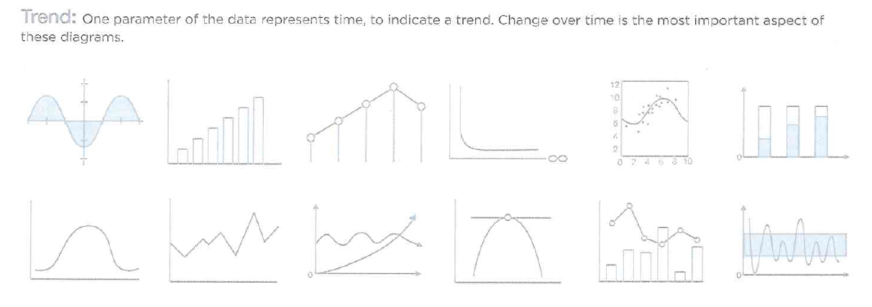
Realistic Concepts: Display Data

Slide 27
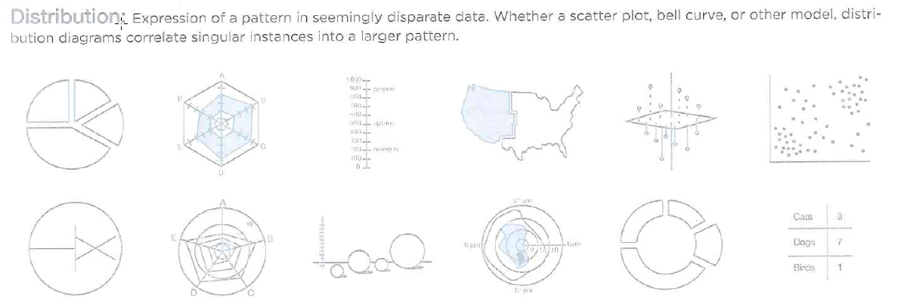
Realistic Concepts: Display Data

Slide 28

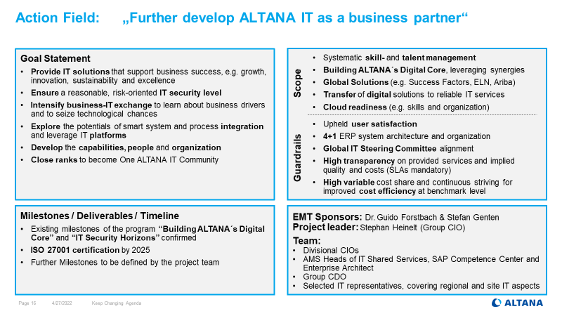
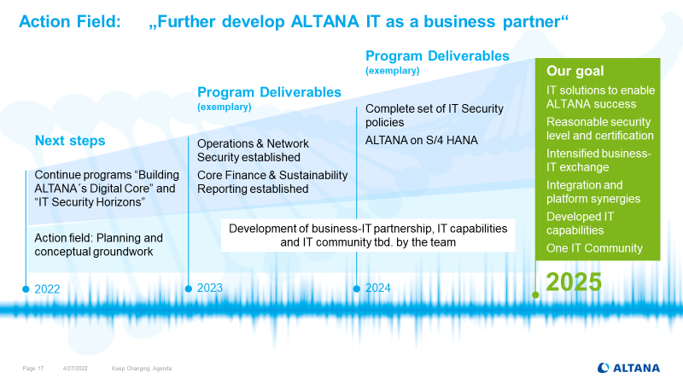
Cloud will support various strategic IT objectives
General objectives that cloud will support
Claim
Objectives
Approach
Accelerate time-to-market solutions for our customers
Enable IT scalability: support ALTANA’s growth with under-proportional cost growth
Make IT more secure and more sustainable by using cloud solutions
Enable cost flexibility & optimization (also downscaling!) to reduce risk
Embrace technology- and digitalization opportunities on a state-of-the-art level
Realize maximum benefits from given platform providers / cost
Provide attractive jobs at a modern and digital workplace for ALTANA employees
Especially, make ALTANA IT organization attractive for young IT professionals
Objectives in alignment with
Keep Changing Agenda 2022
Notes:
X zahlt ein auf Y (Liste von Punkten)

Slide 29
ALTANA needs to leverage cloud opportunities proactively – in a controlled approach
Approach – stages & initiatives
Claim
Objectives
Approach
Migration & Reinvent
3
Leveraging cloud platforms and reaping benefits
Get the most out of it, raise synergies
e.g.: SAP BTP, FIORI, PPM NextGen
Foundations &
Investments
2
Fundamental decisions, implementations & operating models
Lessons learned, invest, setup organization & processes
e.g.: Microsoft (Teams, SharePoint, etc.), D3 Cloud, ServiceNow
Projects & Pilot
1
Initiatives with introductory character
Seek opportunities, try, fail fast, learn faster
e.g.: Security Architecture, Data Center Migration, AI services
Notes:
Steps to heaven

Slide 30
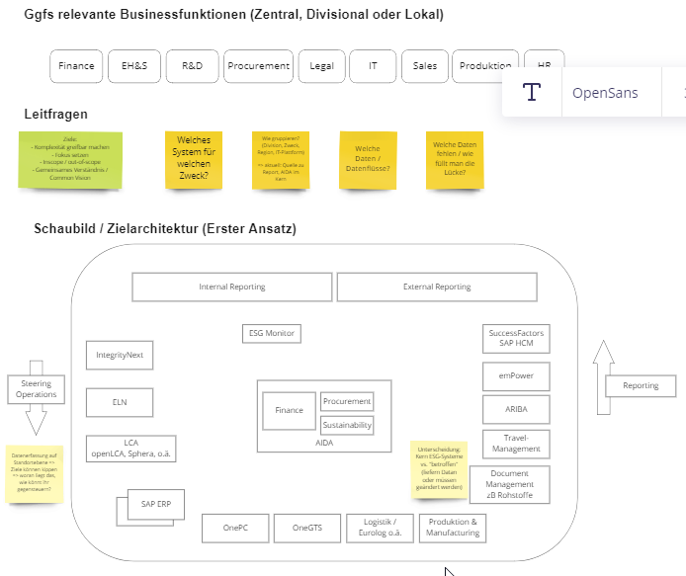



Strategic Impact will affect many business functions and subsequently their IT-systems
Slice the elephant 2a
Gain overview
Consumption
Internal Reporting
External Reporting
SAC
CSRD
Ecovadis
ESG Monitor
Aggregation
AIDA
Azure
Further dedicated Tools
Sources / Operative Systeme
External / References
Steer
ELN
LCA?
D3
SAP
??
Shopfloor / MES
Report
Improve
OnePC
Notes:
Cluster map
Hierarchisch
Landscapes
Grouping

Slide 31
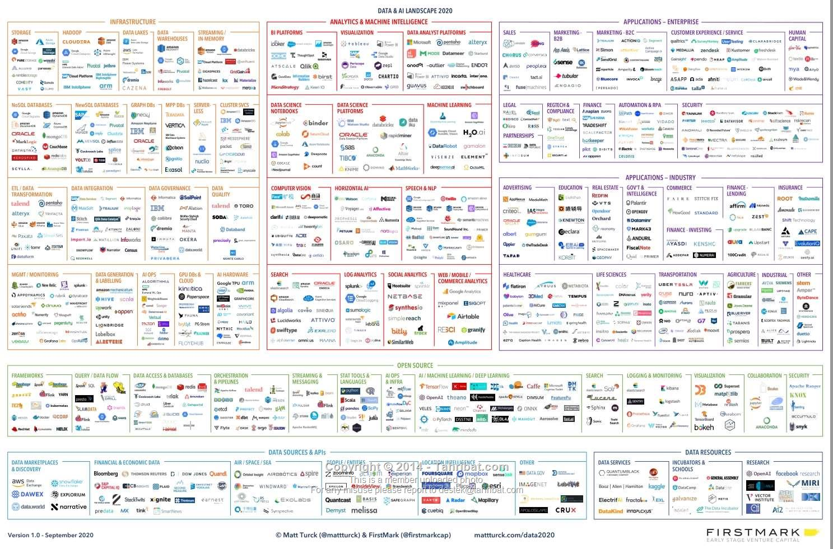
Challenge 1: Myriads of opinions, speculations, technologies and vendors.
Huge landscapes for any major trend topic
Firstmark, Data & AI Landscape 2020
ALTANA Internal Use Only
Notes:
Every hype and mega-trend has its own myriad of opinions and speculations, we could draw similar pictures in each of our digitalization topics. Imagine the 1000+ startups and 100+ consultancies in the AI field – and they all try to sell us something and contact our colleagues with the next big thing, the only platform, the best business case examples – how do we cope with this information overload?
Note 2: AI Landscape might be a bit bigger than others, reason is that while it can be globally applied, AI solutions tend to be very narrow in scope – we do not see or anticipate strong consolidations.

