Slide 1
Grammar
Days, Months and Seasons

Slide 2
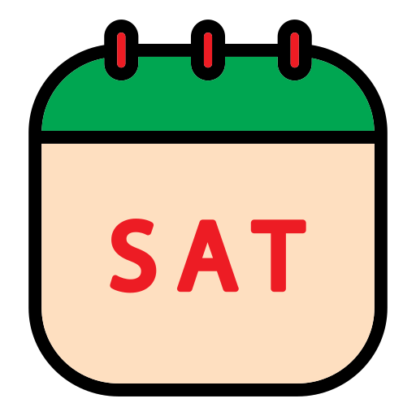
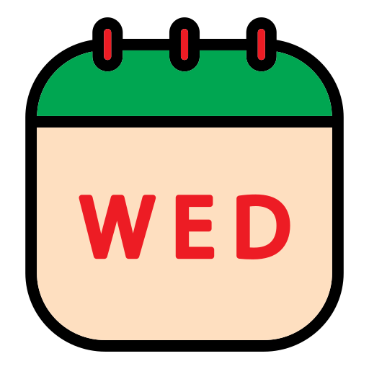
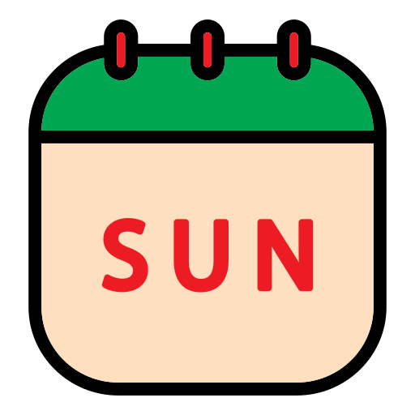
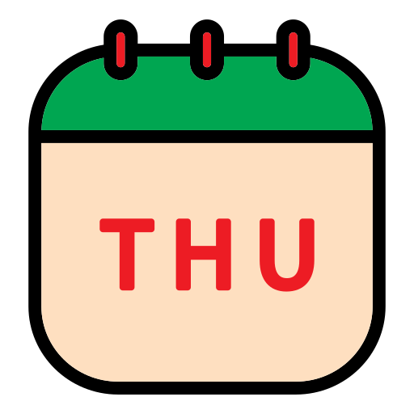
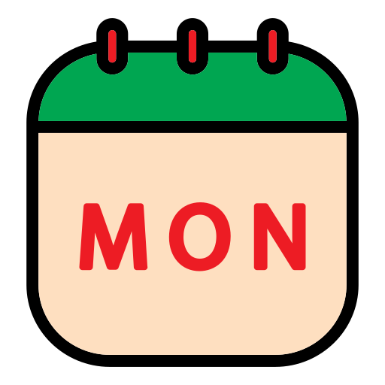
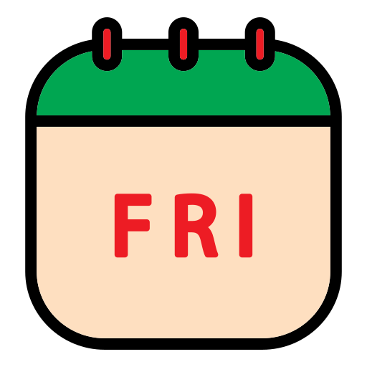
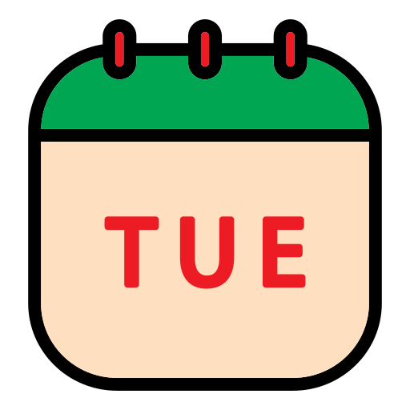
How many days are there in a week?
7 days.
Saturday ‌
Wednesday ‌
Sunday ‌
Thursday ‌
Monday ‌
Friday ‌
Tuesday ‌

Slide 3
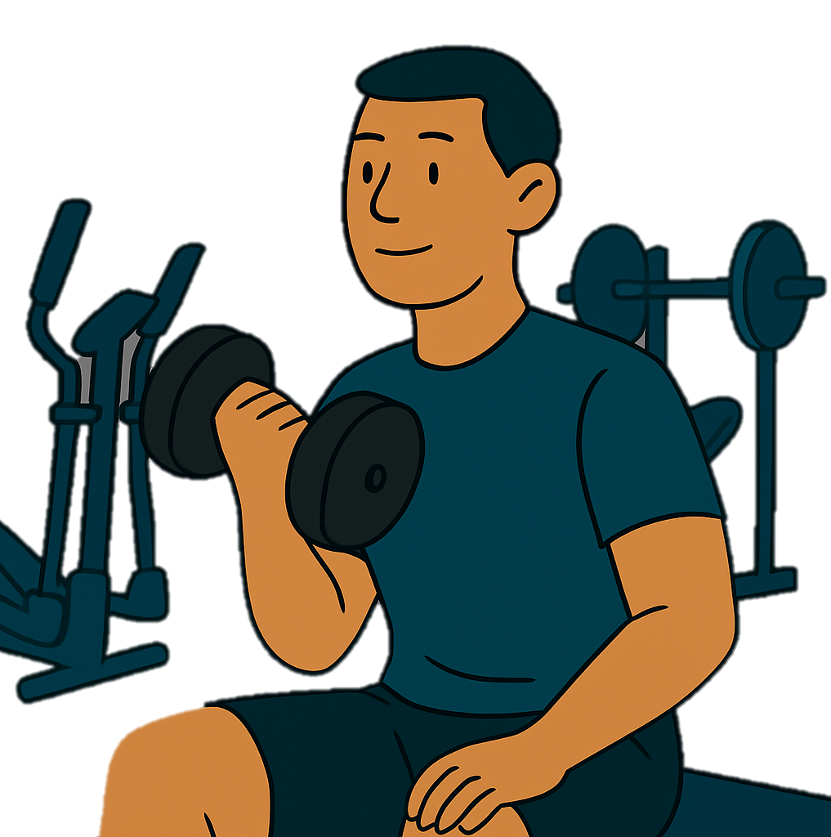
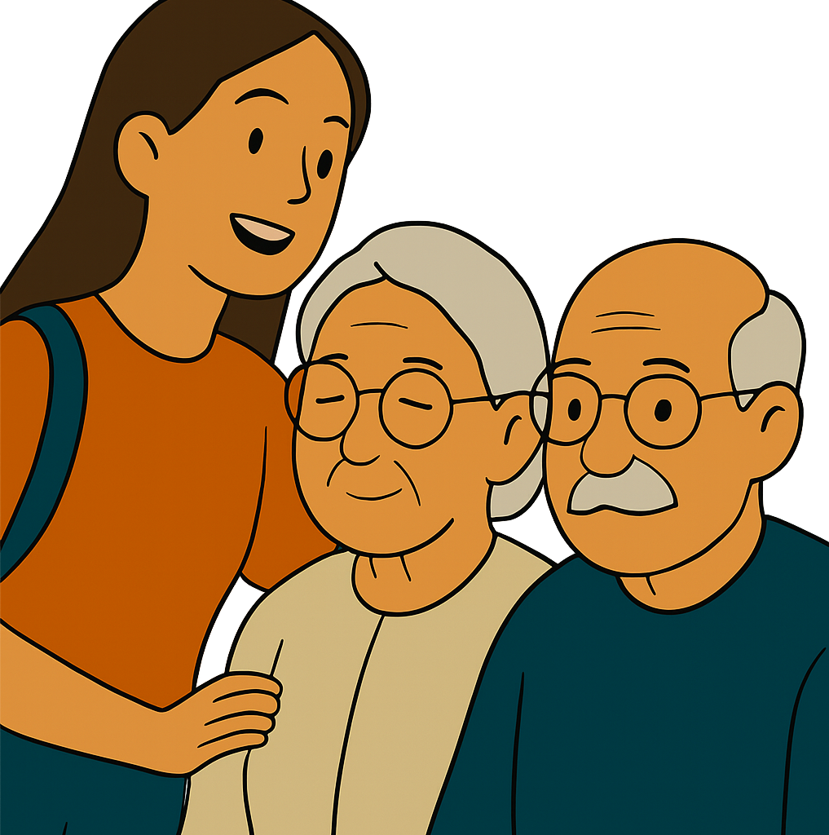
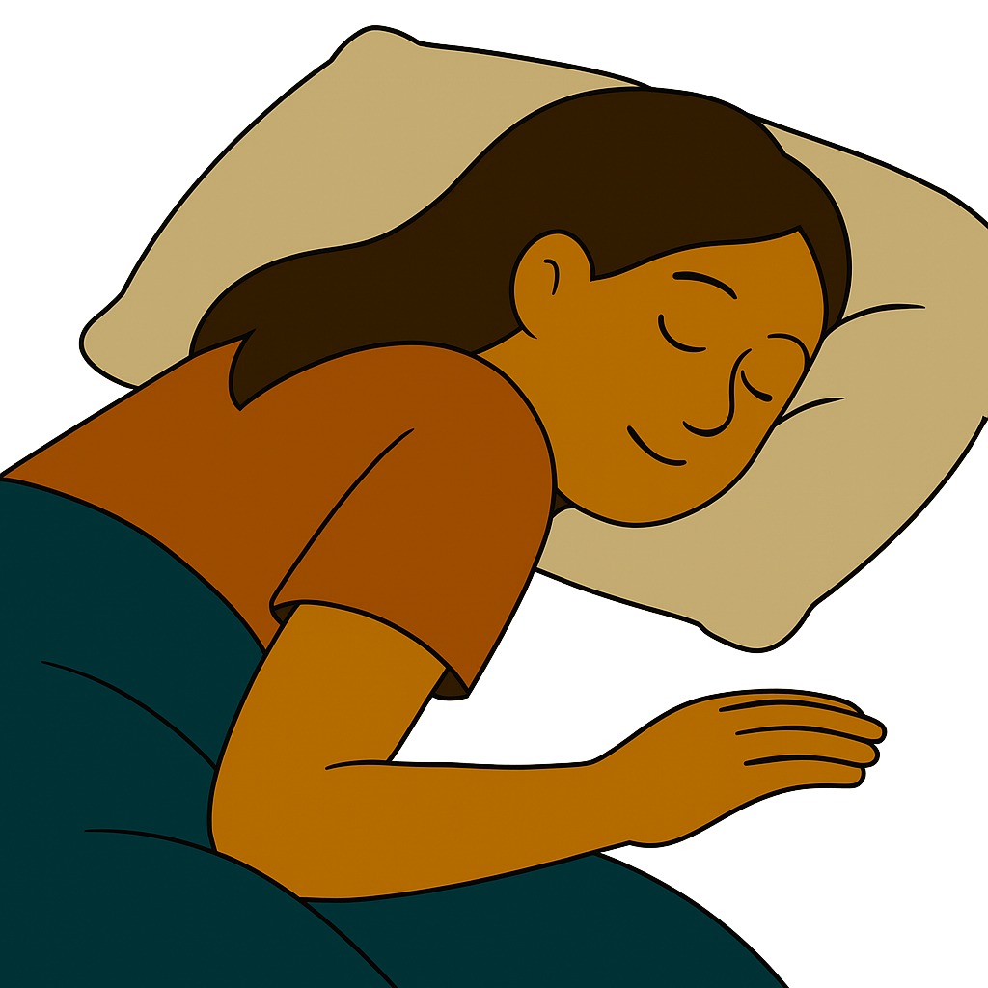
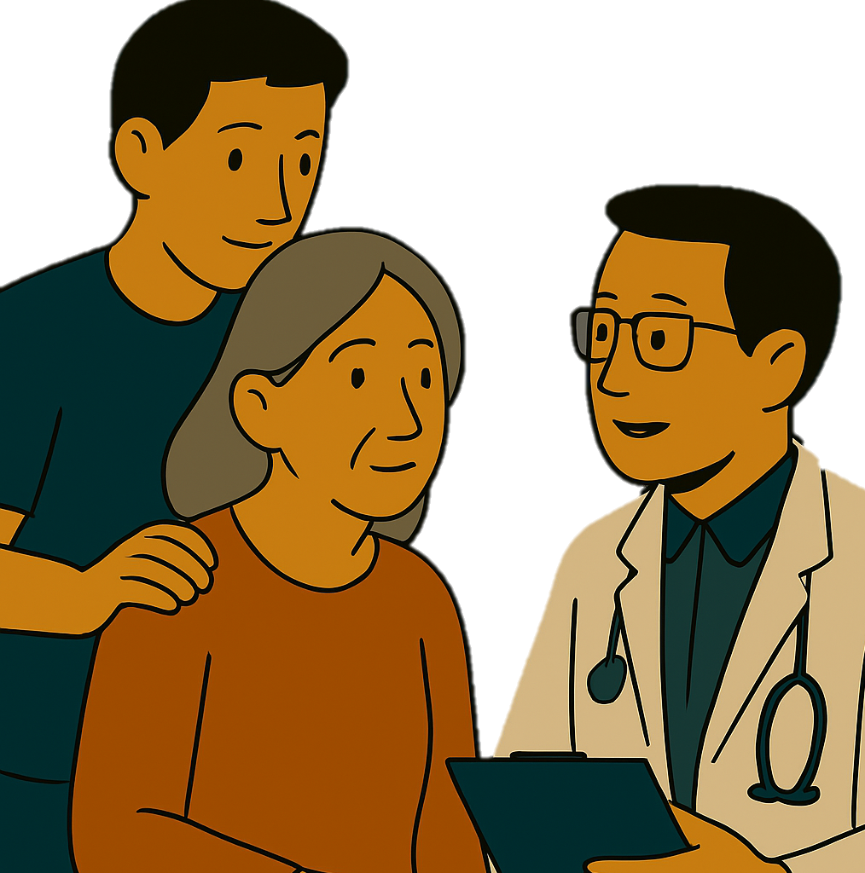
I go to the gym on Saturdays and Mondays.
I visit my grandparents on weekends.
She doesn’t go to work on Fridays.
He takes his mother to the doctor on Sundays.

Slide 4
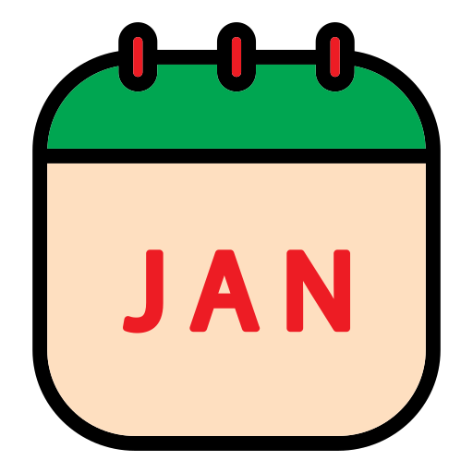
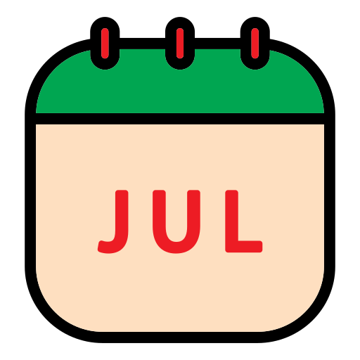

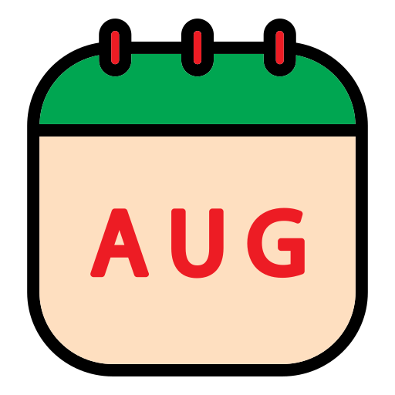
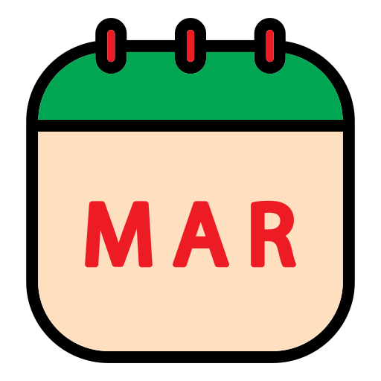
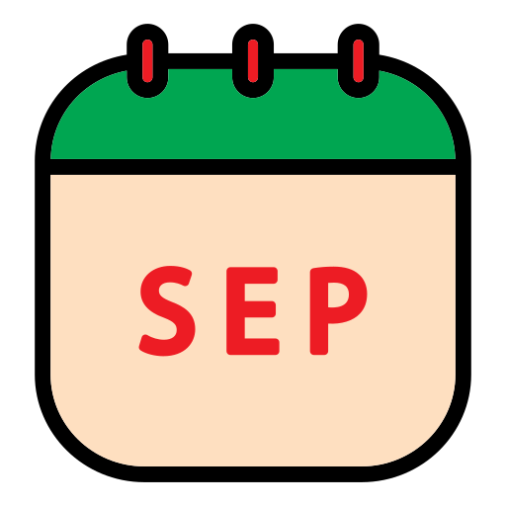
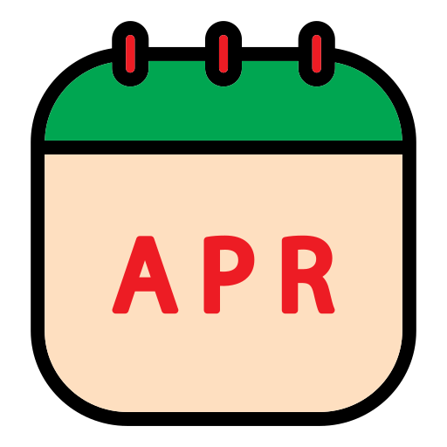
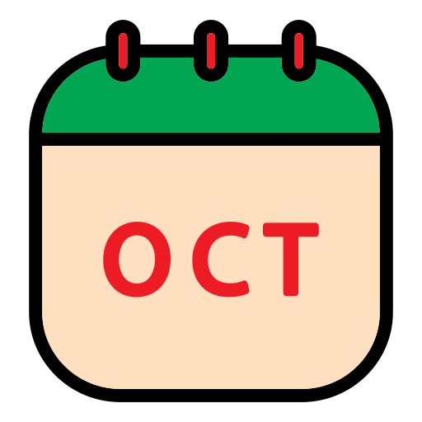
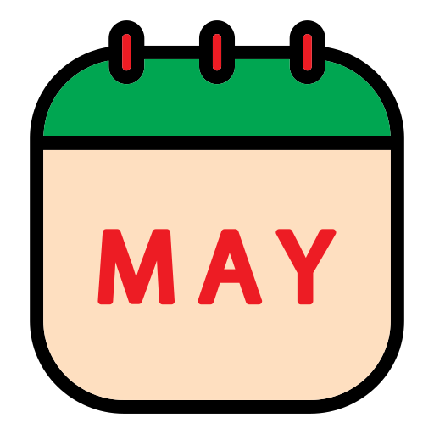
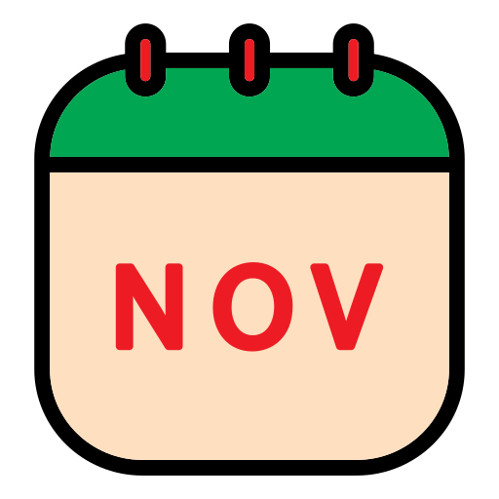
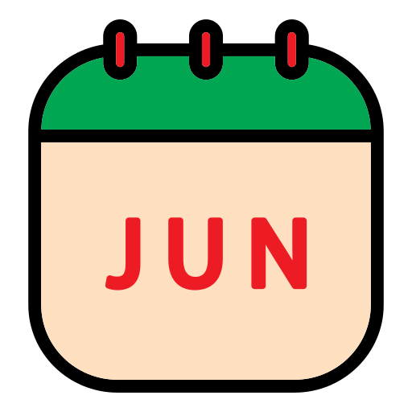
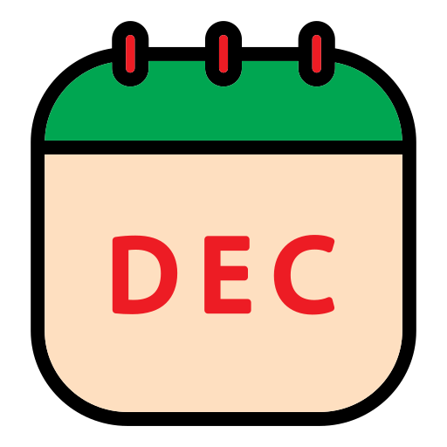
12 months.
How many months are there in the year?
January ‌
July ‌
February ‌
August ‌
March ‌
September ‌
April ‌
October ‌
May ‌
November ‌
June ‌
December ‌

Slide 5
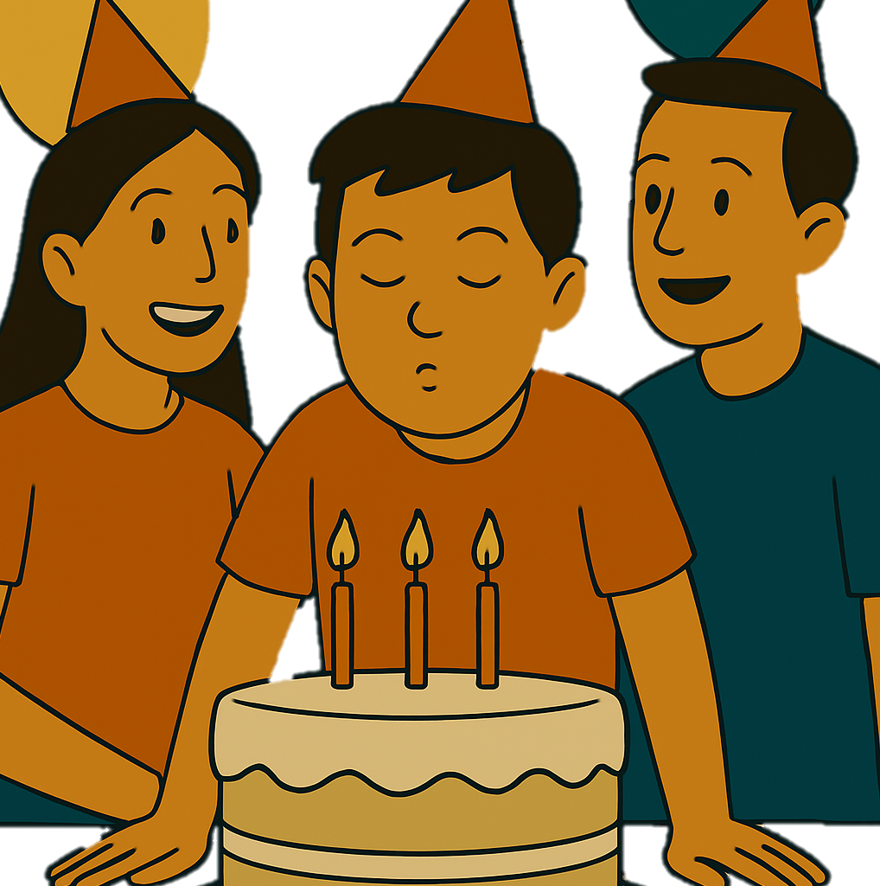
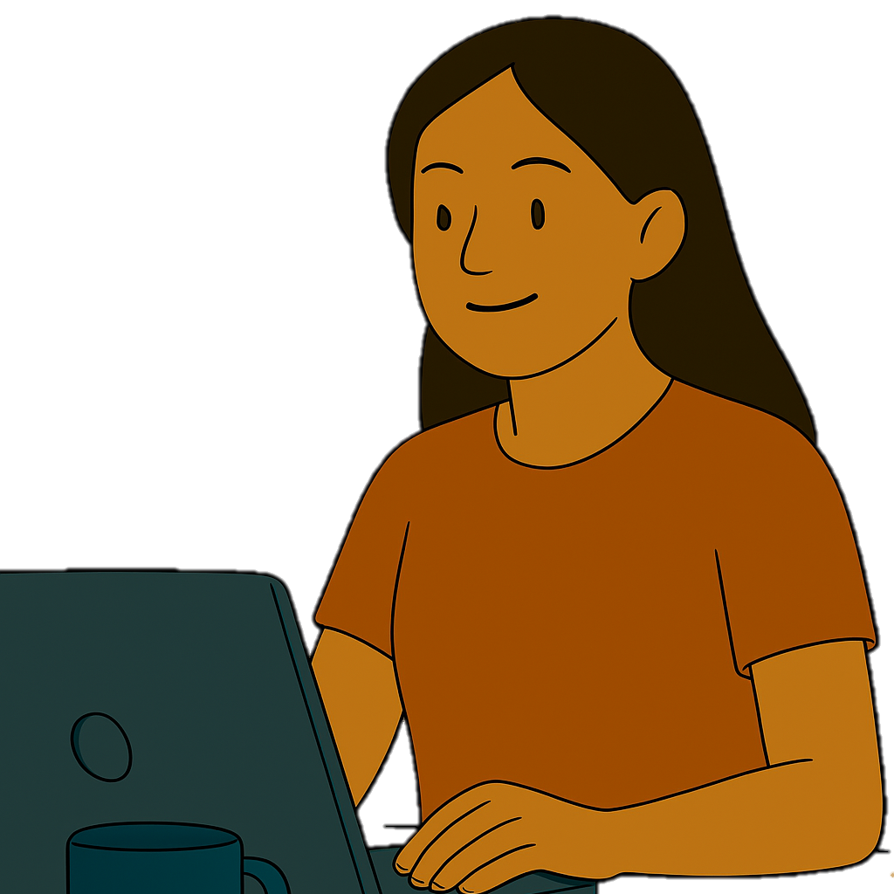
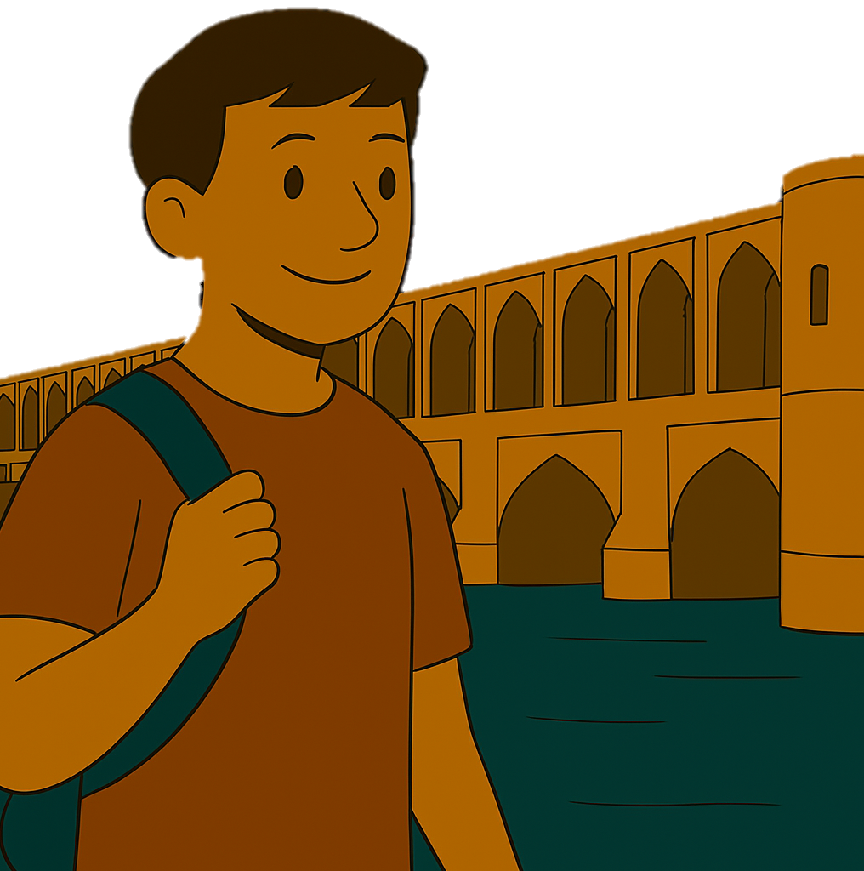
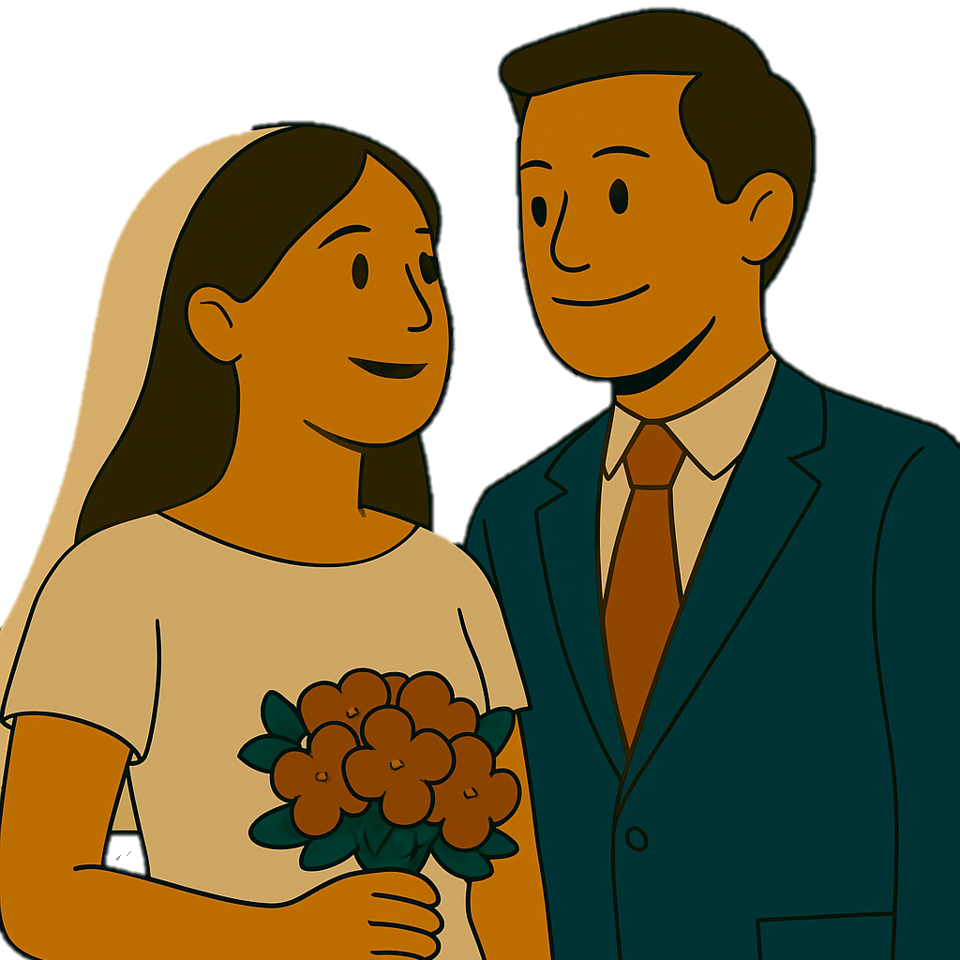
I was born in July.
She started working there in March.
I’m going to Isfahan next April.
They got married in December.

Slide 6



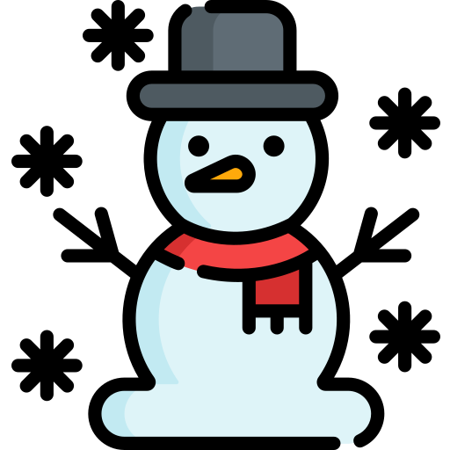
How many seasons are there in the year?
7 seasons.
Spring ‌ (March – May)
Summer ‌ (June – August)
Fall (autumn) (September – November)‌
Winter ‌ (December – February)

Slide 7
1. Which month is your birthday?
2. Which season do you like best?
3. What happens in spring/summer/fall/winter?
4. Which day of the week do you like best? Why?
5. What do you usually do on weekends?

