Slide 1
Grammar
Simple Past

Slide 2
Regular
Irregular
play
played
go
went
wash
washed
eat
ate
rent
rented
drink
drank
talk
talked
tell
told
bake
baked
say
said

Slide 3
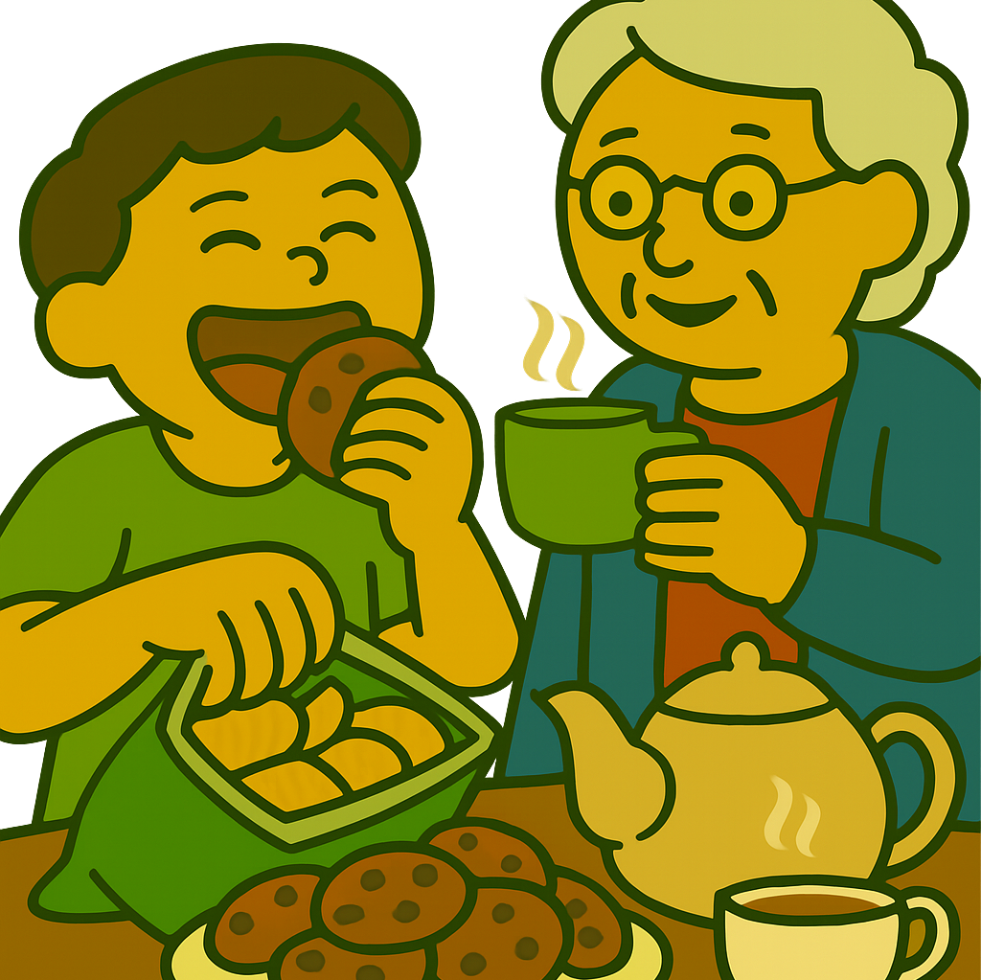
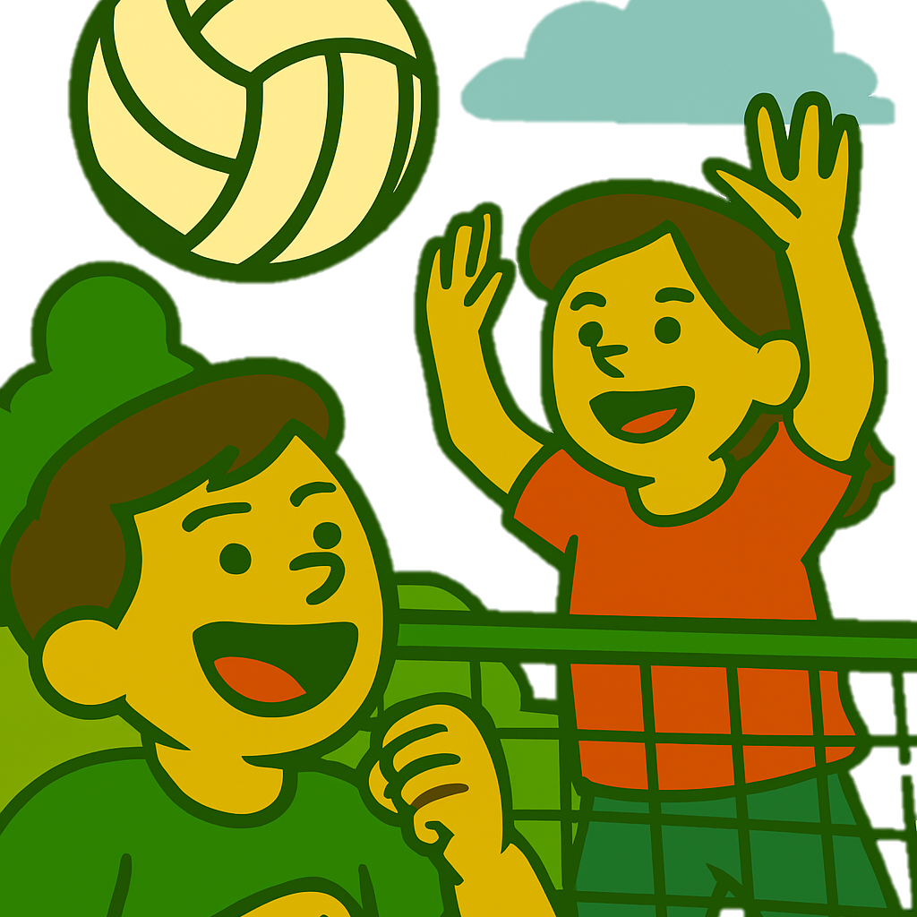
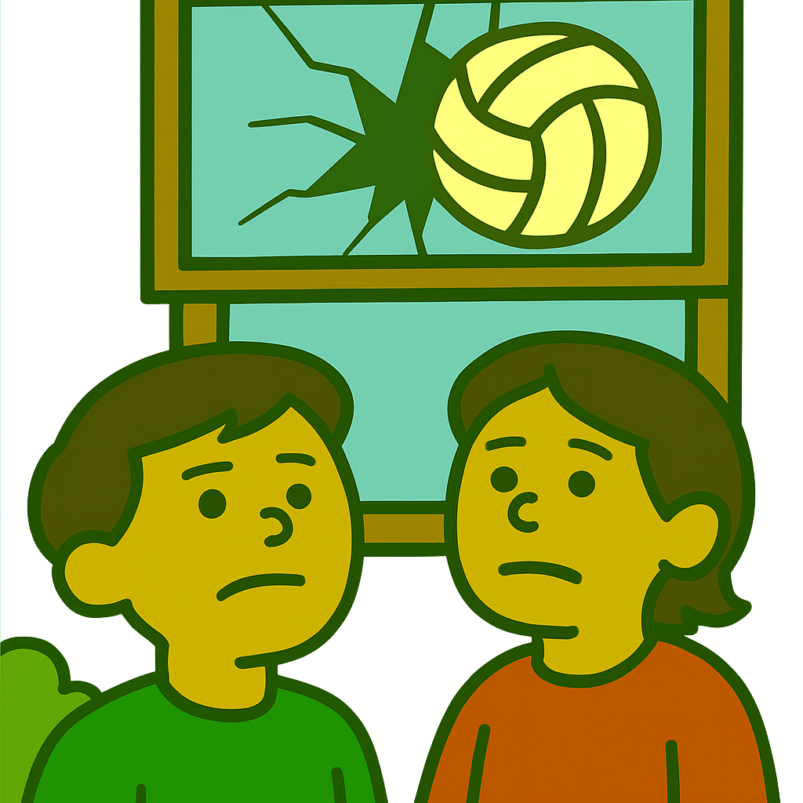
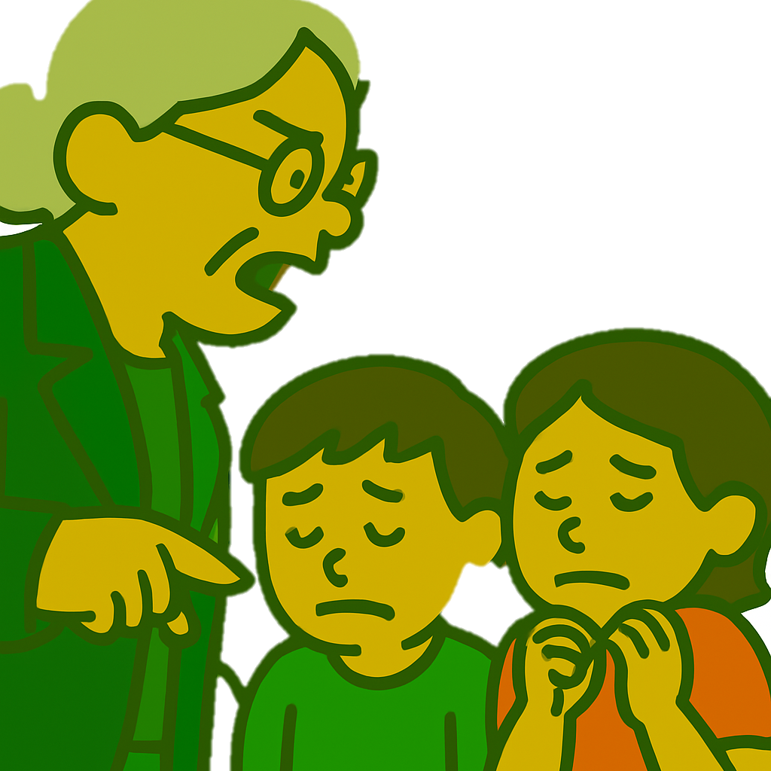
Yesterday, I visited my grandmother. I ate a lot of snacks and drank tea.
Then, my cousins and I went to the yard and played volleyball.
It was so much fun. But all of a sudden, we broke the window.
My grandma became so angry. She shouted at us and made us cry.

Slide 4

I visited my parents last week.
I didn’t visit my parents last week.
She went to work yesterday.
She didn’t go to work yesterday.

Slide 5
We had a party last weekend.
We didn’t have a party last weekend.
He called me last week.
He didn’t call me last week.

Slide 6
Did you call your classmate?
Yes, I did.
No, I didn’t.
Did your sister do her homework?
Yes, she did.
No, she didn’t.

Slide 7
Did we make a mistake?
Yes, we did.
No, we didn’t.
Did he wash the dishes?
Yes, he did.
No, he didn’t.

Slide 8
What did you say?
Where did you go?
When did he arrive?
What time did the concert start?
What time did you go to bed last night?
Why did you lie to me?

Slide 9
Who did you talk to at the party?
Who did you sit next to?
Who washed the dishes?
Who told you about the accident?
How long did you stay at the hotel?
How did you deal with that problem?

Slide 10
lose
lost
pay
paid
read
read
ride
rode
drive
drove
ring
rang
sleep
slept
run
ran
see
saw
sell
sold

Slide 11
buy
bought
choose
chose
think
thought
hear
heard
bring
brought
feel
felt
teach
taught
fall
fell
catch
caught
give
gave

Slide 12
hit
hit
write
wrote
cost
cost
forget
forgot
put
put
leave
left
shut
shut
take
took
cut
cut
know
knew

Slide 13
1
Why you to the bank yesterday?
□ did - went
□ did - go
□ do - went

Slide 14
2
I dinner last night, because I hungry.
□ don't eat - am not
□ didn't ate - was not
□ didn't eat - was not

Slide 15
3
I early this morning, because I late last night.
□ didn't get up - slept
□ didn't got up - sleep
□ didn't sleep - got up

Slide 16
4
Sorry I you. I totally it.
□ called - forget
□ didn't call - didn't forget
□ didn't call - forgot

Slide 17
5
What you to her?
□ were - say
□ did - say
□ did - said

Slide 18
6
I him to be honest with me, but he to me again.
□ ask - lied
□ didn't ask - lie
□ asked - lied

