Slide 1
Grammar
Past of To Be verbs

Slide 2
I am
I was ‌
I wasn’t ‌
You are
You were ‌
You weren’t ‌
We are
We were ‌
We weren’t ‌
They are
They were ‌
They weren’t ‌
He is
He was ‌
He wasn’t ‌
She is
She was ‌
She wasn’t ‌
It is
It was ‌
It wasn’t ‌

Slide 3

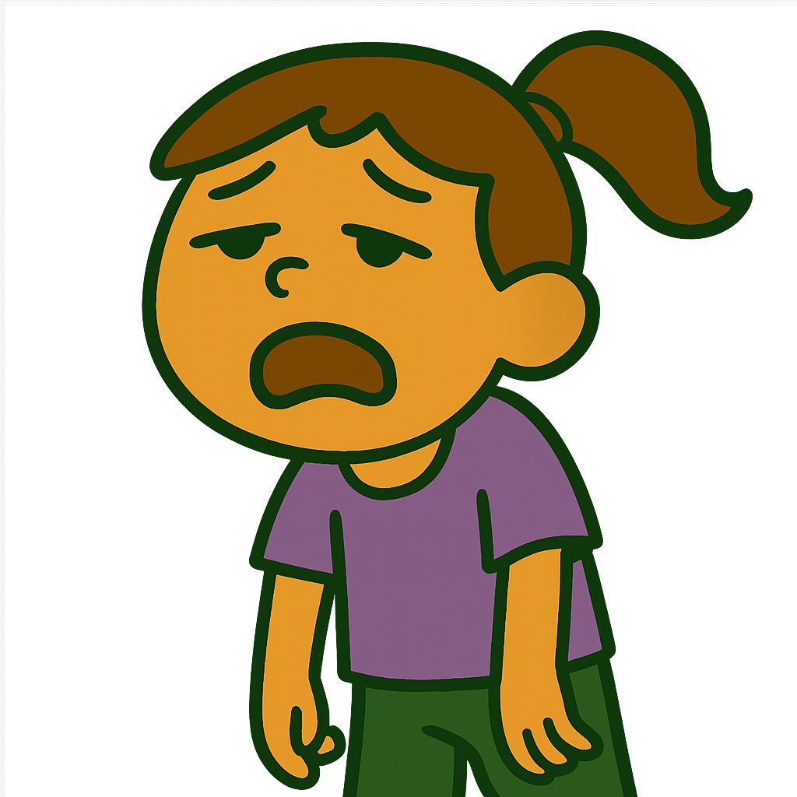
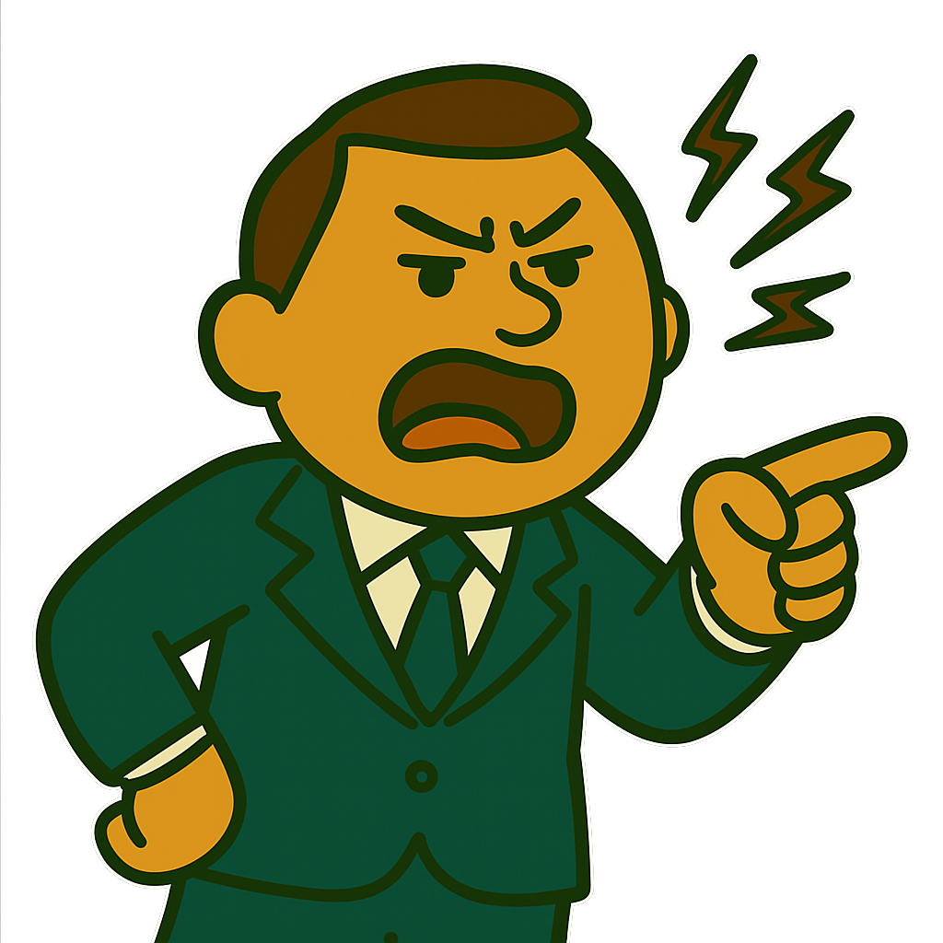
I was very excited about my trip.
My sister was very tired last night.
My boss was in a bad mood last week.

Slide 4


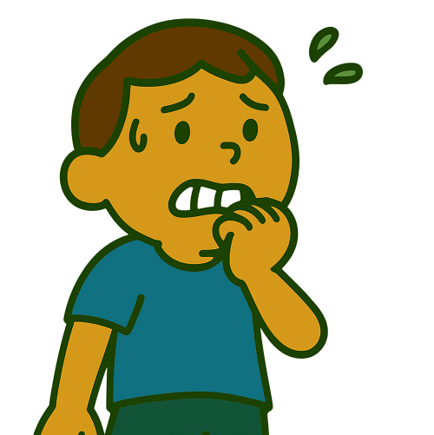
The party wasn’t boring. It was so much fun.
The food was so delicious.
You were a little nervous yesterday.

Slide 5
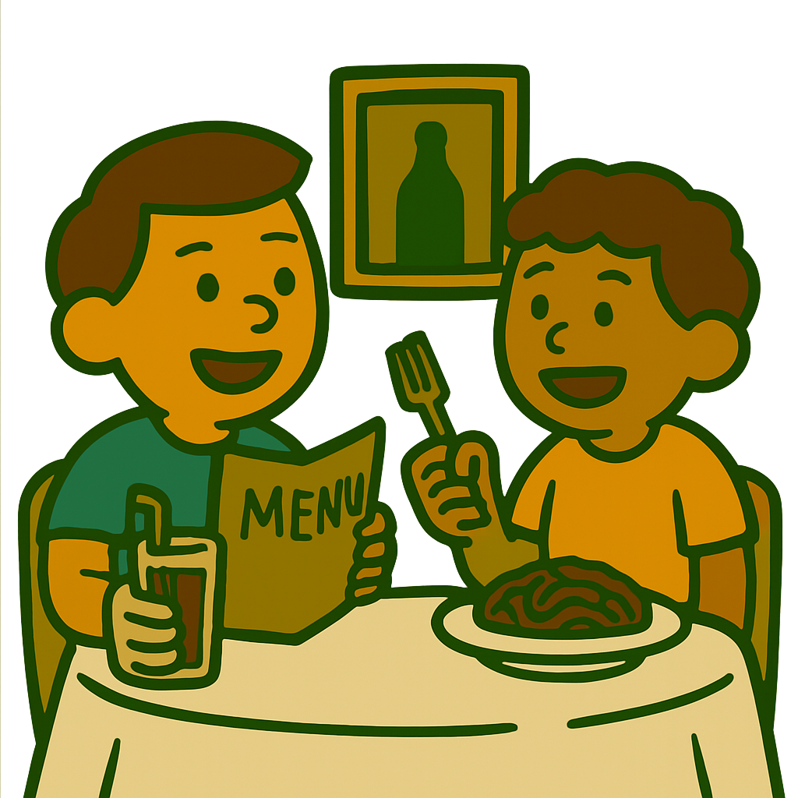
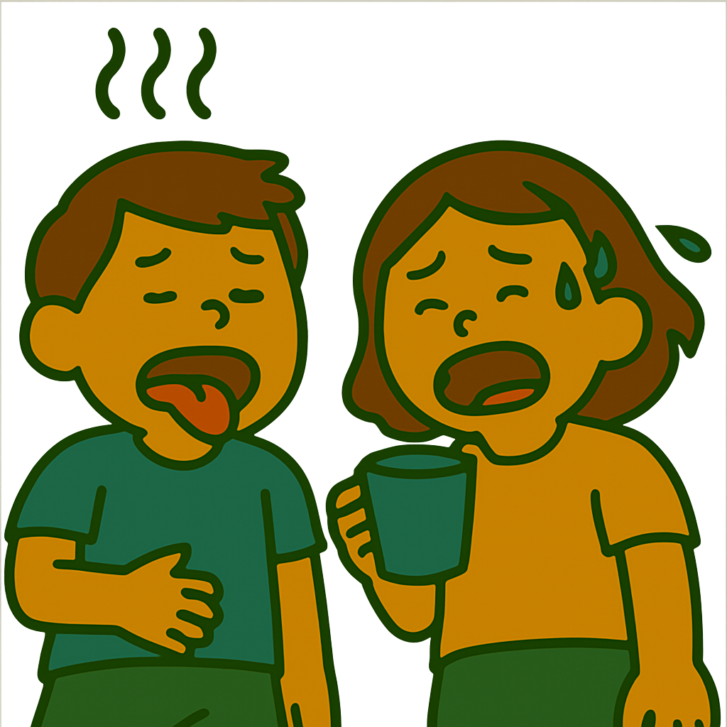
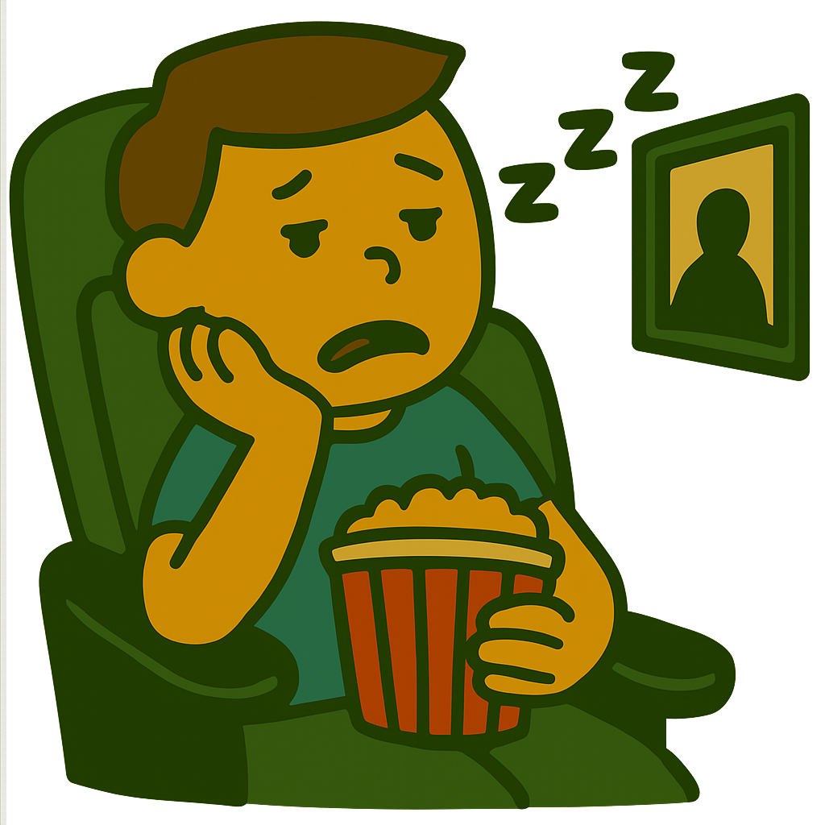
My friend and I were at the restaurant at 1:00 P.M.
The children were hungry and thirsty.
The movies weren’t fantastic.

Slide 6


Was he a good teacher?
Yes, he was .
No, he wasn’t .
Was she helpful?
Yes, she was .
No, she wasn’t .

Slide 7

Were the sneakers expensive?
Yes, he was .
No, he wasn’t .

Slide 8
What was the problem?
How was the party/food/movie?
Where were you yesterday morning?
When was he born?
Why was she so angry last week?
How long were they in the hospital?

