Slide 1
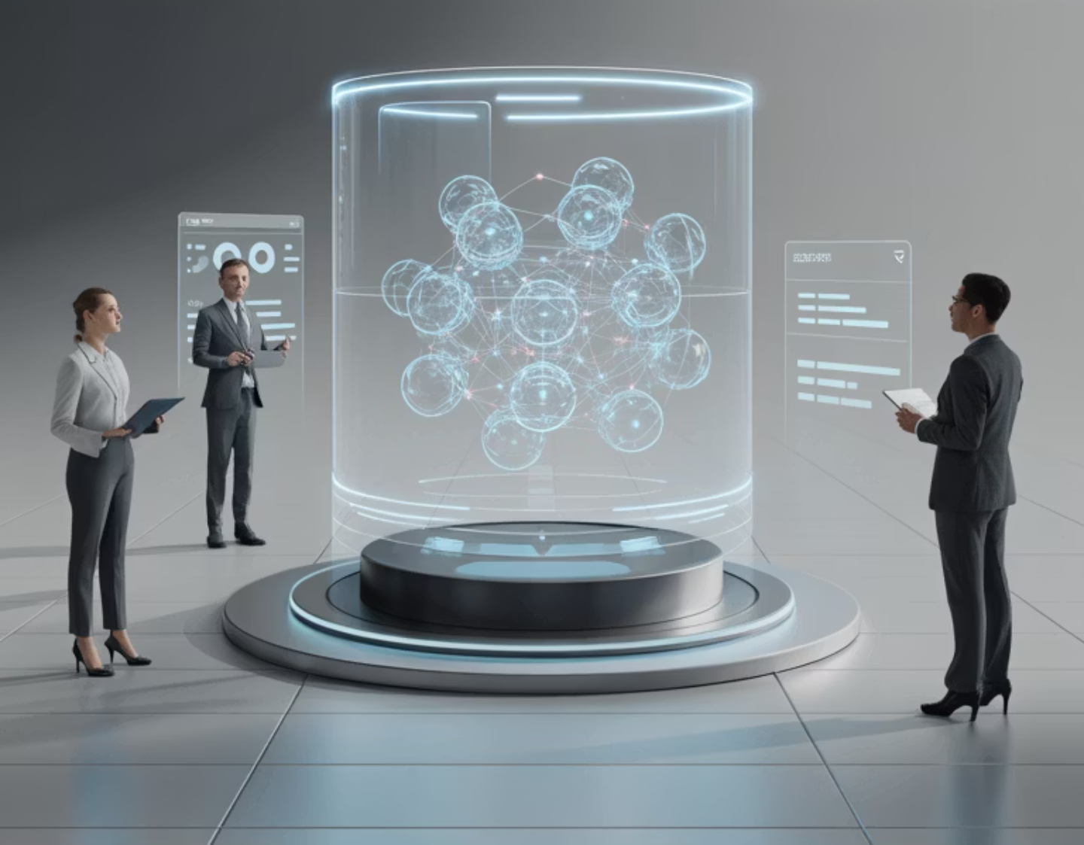

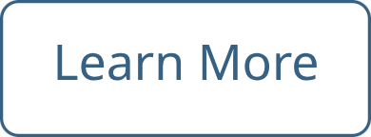
AI & IT at AMETAZ GROUP: Architecting Digital Transformation
Fostering Boundless Innovation, and Cultivating Global Leadership

Slide 2
The Digital Imperative:
Necessity of Organizational Metamorphosis
In the contemporary business landscape, information technology and artificial intelligence have transcended their roles as mere ancillary tools to emerge as the fundamental pillars underpinning organizational growth, competitiveness, and long-term viability. As the momentum of digital transformation accelerates, enterprises that fail to modernize their IT infrastructure and harness the potential of artificial intelligence face swift obsolescence.
AMETAZ GROUP, possessing a profound understanding of this paradigm shift, has meticulously architected its AI & IT services upon the core tenets of integration, innovation, and sustainable value creation. By amalgamating multidisciplinary expertise across technology, commerce, and international spheres, the company serves as a steadfast navigator for organizations embarking on their digital transformation odyssey, empowering them not only to achieve operational excellence but to conceive and implement entirely novel business paradigms.

Slide 3
A Global Perspective on AI & IT:
Redefining Beyond Conventional Infrastructure
In the modern lexicon, information technology and artificial intelligence are inextricably linked facets of a single entity, synergistically forging intelligent systems endowed with the capacity for continuous learning, adaptation, and optimization. This domain can be delineated across three primary dimensions:
1
2
3
IT Infrastructure
Artificial Intelligence & Machine Learning
Integration & Automation
This encompasses the entire spectrum of hardware, software, networks, and storage systems that constitute the bedrock of an organization's daily operations. A forward-looking approach dictates that IT infrastructure must be inherently agile, scalable, secure, and cloud-native to adequately serve the dynamic exigencies of digital enterprises. Foundational concepts such as Cloud Computing, the Internet of Things (IoT), and Software-Defined Networking (SDN) are integral components of this domain.
This sphere concentrates on the seamless interconnection of disparate systems, the automation of business processes, and the engineering of intelligent workflows. Key enablers within this category include Enterprise Integration Platforms as a Service (iPaaS), Robotic Process Automation (RPA), and intelligent automation platforms. The primary goal is the eradication of organizational silos and the establishment of cohesive information flows and integrated processes.
This discipline is dedicated to engineering systems capable of executing tasks that traditionally necessitate human cognition. It encompasses specialized subfields including Deep Learning, Natural Language Processing (NLP), Computer Vision, and Expert Systems. The paramount objective is the creation of autonomous systems capable of learning from data, generating accurate predictions, and rendering intelligent decisions.

Slide 4
Pivotal Challenges in the Global AI & IT Arena
Organizations navigating the digital transformation landscape confront a myriad of intricate challenges that demand innovative solutions and a synthesis of cross-functional expertise:
Legacy Systems
Big Data Deluge
A significant number of organizations grapple with antiquated systems whose integration with contemporary technologies is both arduous and prohibitively expensive.
The velocity of data generation has surpassed the processing capabilities of traditional frameworks, necessitating novel infrastructures and sophisticated algorithms.
Sophisticated Cyber Threats
Talent Scarcity
The increasing complexity of cyberattacks mandates the deployment of intelligent, preemptive defense systems.
The demand for proficient AI & IT professionals vastly outstrips supply, engendering intense competition for their acquisition and retention.
Change Aversion
Regulatory Flux
Resistance to automation and digital transformation among employees and management necessitates astute change management strategies.
The legislative landscape governing data privacy (e.g., GDPR) and artificial intelligence is in a state of perpetual evolution, requiring continuous compliance adaptation.

Slide 5










The AMETAZ GROUP Methodology:
A Triad of Integration, Innovation, and Value Creation
Data-Centric Platforms
Enterprise Architecture Integration
The establishment of robust data infrastructures that facilitate the collection, storage, processing, and analysis of voluminous datasets with exceptional velocity and precision. These platforms comprise Data Lakes, Data Warehouses, and advanced analytics ecosystems.
The design of IT architectures that comprehensively address all facets of the business while furnishing the requisite agility for future evolution. This methodology encompasses the integration of legacy systems with modern platforms, the standardization of processes, and the formulation of long-term digital roadmaps.
Operational AI
The deployment of AI systems that directly influence and enhance daily organizational operations. This includes predictive systems, intelligent process automation, and decision-support frameworks that facilitate more expeditious and precise decision-making.
Change Management & Empowerment
Guiding organizations through the digital transformation continuum via comprehensive employee training, resistance mitigation, and the cultivation of a culture steeped in innovation and technological adoption. This pillar encompasses tailored training programs, immersive workshops, and perpetual support systems.
Proactive Cybersecurity
The strategic application of artificial intelligence and behavioral analytics to identify and neutralize security threats prior to materialization. This approach leverages anomaly detection systems, user and entity behavior analytics (UEBA), and automated incident response protocols.

Slide 6
Specialized Domains of AI & IT Service Delivery
AMETAZ GROUP delivers its specialized services across six distinct domains, each demanding unique expertise and bespoke methodologies:
Digital Strategy Consulting
Systems Integration & Automation
This service assists organizations in formulating long-term digital strategies. Offerings include digital maturity assessments, identification of transformation opportunities, digital roadmap design, and the definition of key performance indicators. The central focus is the strategic alignment of digital initiatives with overarching business objectives to forge sustainable competitive advantages.
This area focuses on the interconnection of heterogeneous organizational systems and the automation of business processes. Services include the implementation of integration platforms (iPaaS), development of Robotic Process Automation (RPA) solutions, design of intelligent workflows, and creation of unified portals for both employees and customers.
Cybersecurity & Risk Management
Cloud & Modern Infrastructure Implementation
This service is dedicated to safeguarding an organization's digital assets from the spectrum of cyber threats. Offerings include vulnerability assessments, secure architecture design, implementation of Intrusion Detection/Prevention Systems (IDS/IPS), Identity and Access Management (IAM), and comprehensive incident response planning.
This domain involves the design, implementation, and governance of modern IT infrastructures predicated on cloud computing principles. Services encompass cloud migration, the design of elastic cloud architectures, implementation of container orchestration platforms (e.g., Kubernetes), and Infrastructure as Code (IaC) management.
Data Analytics & Business Intelligence
AI & ML Solutions
This domain is dedicated to the transmutation of raw data into actionable intelligence that facilitates superior decision-making. Services include the design of executive dashboards, development of interactive reports, implementation of Business Intelligence platforms (e.g., Power BI, Tableau), and advanced data analysis leveraging data science methodologies.
This service is centered on the design and implementation of bespoke AI systems engineered to address specific business challenges. Offerings include the development of predictive models, recommendation engines, intelligent conversational agents (chatbots), computer vision systems, and natural language processing applications. Each solution is meticulously tailored to the unique requirements of the client organization.

Slide 7








Core Competencies and Distinctive Capabilities
The success of AMETAZ GROUP in delivering superior AI & IT services is attributable to a unique amalgamation of specialized team expertise spanning technology, commerce, and international experience:
Advanced Enterprise Architecture
Artificial Intelligence & Deep Learning
Proficiency in architecting scalable, resilient, and agile IT frameworks.
Mastery of advanced machine learning algorithms and deep neural network architectures.
Extensive experience in integrating legacy systems with cutting-edge platforms.
Proven track record in developing computer vision and natural language processing systems.
Acumen in process standardization and long-term digital roadmap formulation.
Expertise in optimizing AI models for peak performance within operational environments.
Data Engineering & Science
Cybersecurity & Risk Management
Profound knowledge of modern data architecture design (Data Lakes, Data Warehouses, Data Meshes).
Expertise in designing secure-by-architecture systems and implementing defense-in-depth strategies.
Experience in engineering robust data pipelines for high-volume, high-velocity data processing.
Proficiency in Identity and Access Management (IAM) and Role-Based Access Control (RBAC).
Skill in advanced data analytics and the extraction of actionable, strategic insights.
Skill in conducting vulnerability assessments and developing comprehensive incident response plans.
Cloud Computing & Modern Infrastructure
Systems Integration & Automation
In-depth knowledge of major hyperscaler platforms (AWS, Azure, Google Cloud).
Command of enterprise integration platforms (iPaaS) and API management.
Experience in complex cloud migration strategies and cloud financial operations (FinOps).
Experience in developing Robotic Process Automation (RPA) solutions and intelligent workflow orchestration.
Expertise in Infrastructure as Code (IaC) and GitOps methodologies.
Skill in creating seamless connectivity between legacy systems and modern APIs.
Business Analysis & Change Management
Software Development & DevOps
Deep understanding of business process optimization and identifying transformative opportunities.
Knowledge of agile software development methodologies (Agile, Scrum, DevOps, Site Reliability Engineering).
Experience in organizational change management and overcoming institutional resistance.
Experience in implementing continuous integration/continuous deployment (CI/CD) pipelines.
Expertise in designing and executing targeted training and employee enablement programs.
Skill in managing the complete software development lifecycle (SDLC).

Slide 8
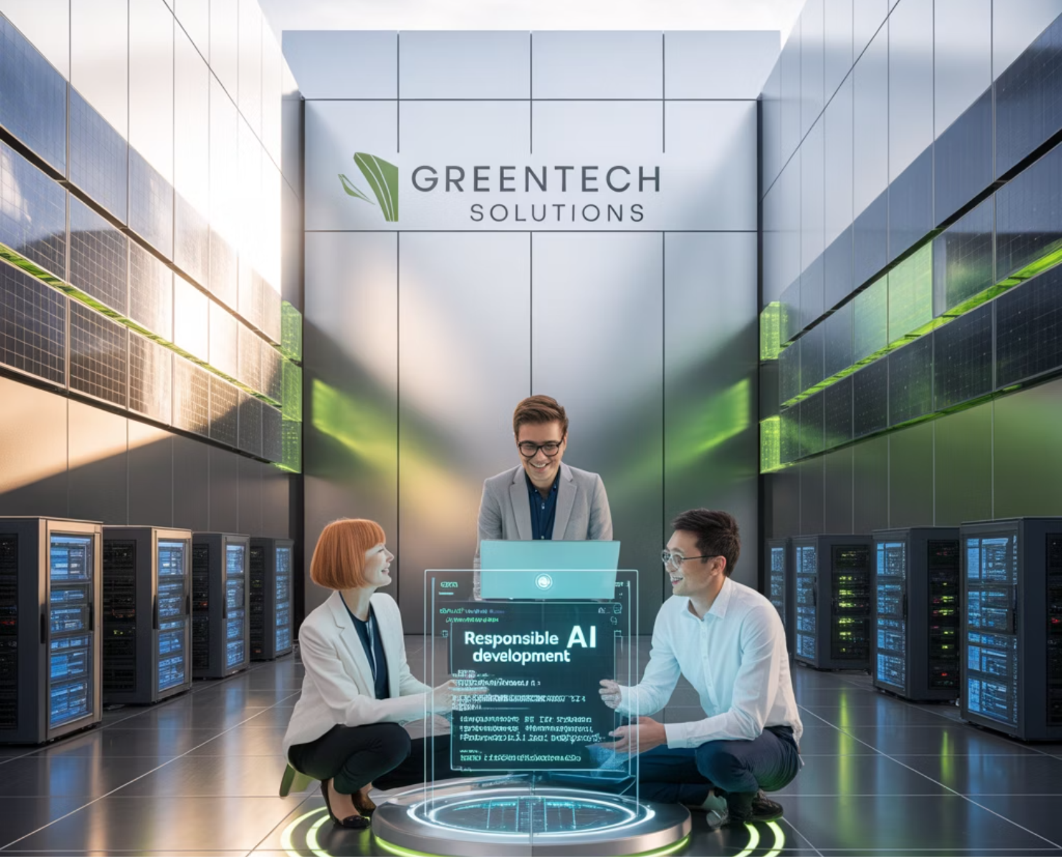
Strategic Advantages of Partnership & Commitment to Responsible Technology
Strategic Advantages
Responsible Technology
Engaging with AMETAZ GROUP in the realm of artificial intelligence and information technology confers a multitude of strategic advantages, providing access to a synthesis of multidisciplinary expertise that marries deep technical acumen with nuanced business understanding and global experience to deliver comprehensive, integrated solutions.
AMETAZ GROUP perceives information technology and artificial intelligence not merely as technical instruments, but as catalysts for generating a positive societal and environmental impact. This commitment is actualized across three principal domains:
The group's unwavering commitment to perpetual innovation, through the application of emergent technologies and methodologies, positions client organizations at the vanguard of their respective industries. Its bespoke solutions are meticulously crafted to align with the specific needs, objectives, and constraints of each organization, factoring in industry context, scale, and growth trajectory.
Green IT
Designing energy-efficient IT infrastructure, utilizing cloud resources powered by renewable energy, and managing the hardware lifecycle to minimize e-waste.
Project execution adhering to industry best practices and global standards mitigates the risk of failure and expedites time-to-value, while continuous post-implementation support and maintenance services ensure sustained peak performance and adaptability to evolving requirements. The transfer of knowledge to internal teams, fostering self-sufficiency in managing technology solutions, coupled with a steadfast focus on delivering quantifiable business value—such as enhanced productivity, cost optimization, or superior customer experiences—rounds out the key benefits of this strategic alliance.
Responsible AI
Emphasizing the development of equitable, unbiased systems, transparency in algorithmic decision-making, and the rigorous protection of data privacy and information security.
Positive Social Impact
Realized through the development of technology-driven solutions for societal challenges, support for technology education initiatives, and the promotion of equitable access to transformative innovations.

Slide 9





Conclusion: Empowering Your Digital Transformation Journey
"At AMETAZ GROUP, we envision technology not merely as a tool, but as the central nervous system of future organizations; an intelligent, integrated, and human-centric system endowed with the power to forge a better world."
In today's digitally-driven world, organizational success is contingent upon the ability to effectively leverage information technology and artificial intelligence. With a profound appreciation for this imperative, AMETAZ GROUP positions itself as the strategic partner of choice for organizations navigating their digital transformation journey.
Integration
Forging cohesive, silo-free systems
Innovation
Applying state-of-the-art technologies and methodologies
Customization
Tailored to the unique context of each client
Sustainability
Embedding social responsibility into all services
Value Creation
Delivering measurable business outcomes
Partnering with AMETAZ GROUP empowers organizations to elevate their IT infrastructure to world-class standards, harness artificial intelligence to augment decision-making and operations, fortify their cybersecurity posture against sophisticated threats, foster a culture of innovation and technological fluency, and generate a positive societal and environmental footprint through responsible technology stewardship.
The confluence of distinctive team expertise, global experience, and a relentless commitment to continuous innovation establishes AMETAZ GROUP as the trusted partner for organizations seeking enduring success in their digital transformation endeavors.

