Slide 1
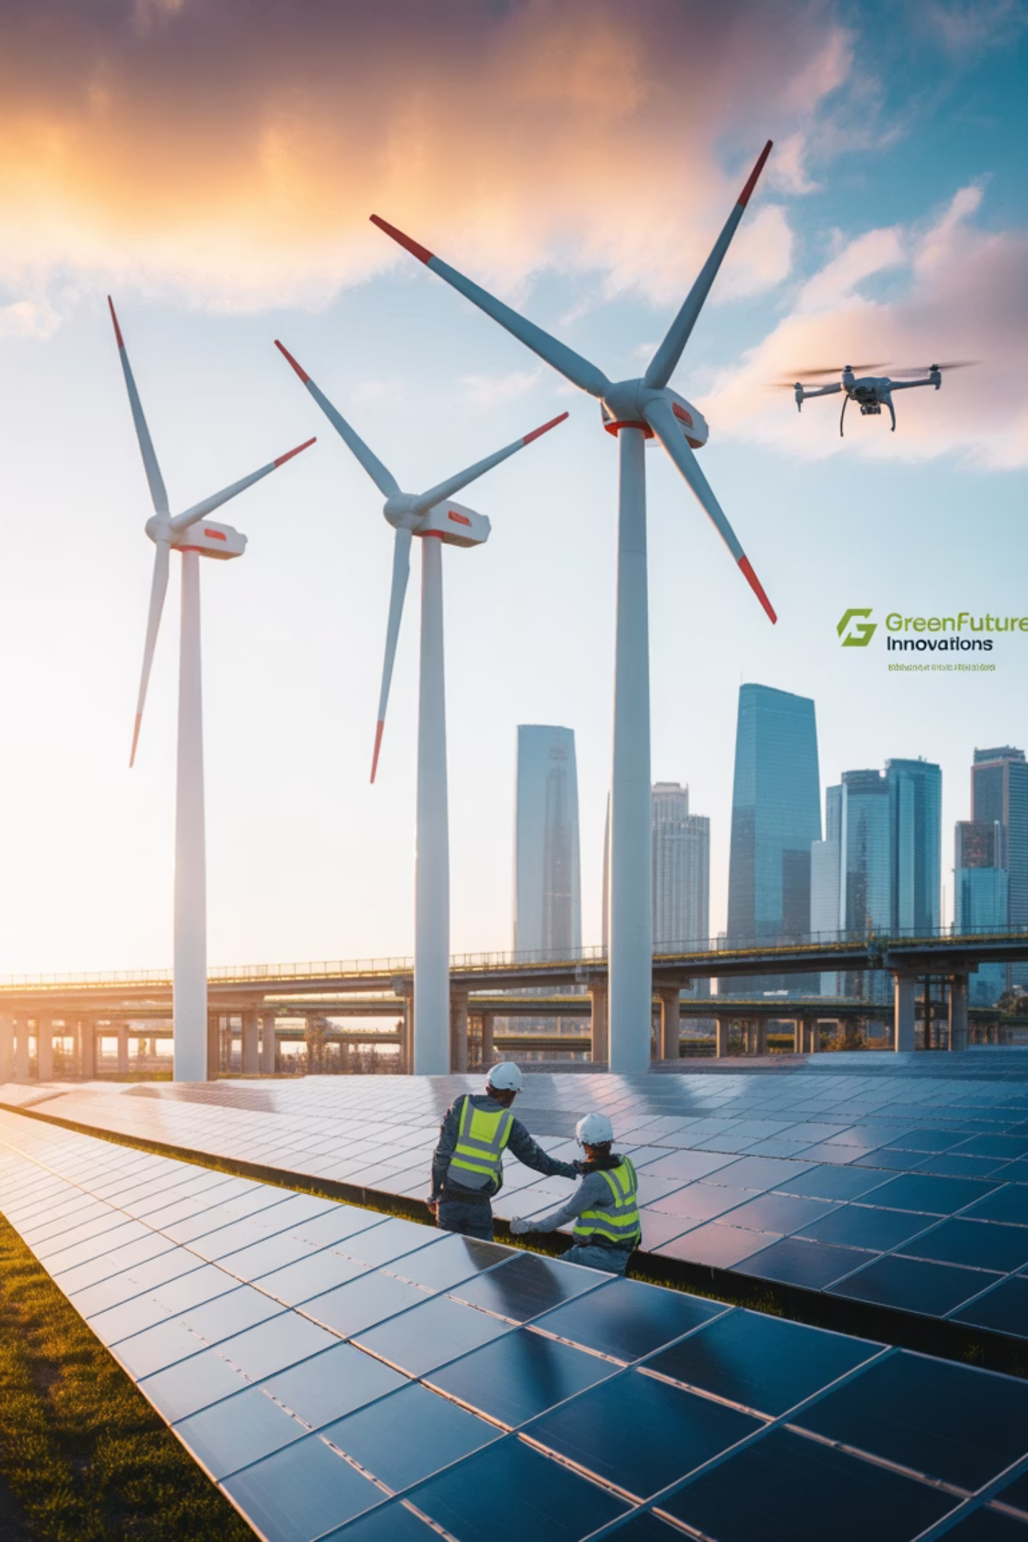
Energy at AMETAZ GROUP: Engineering Sustainable Solutions
Fostering Boundless Innovation and Cultivating Global Leadership

Slide 2

The Energy Transformation and the Imperative for a Sustainable Future
In the twenty-first century, the energy industry stands at a historic inflection point. Amidst escalating concerns over climate change, the depletion of fossil fuel reserves, and an ever-increasing demand for clean energy, the world is rapidly transitioning toward sustainable energy models.
Energy is no longer merely an economic commodity; it has evolved into a cornerstone of sustainable development, national security, and quality of life.
AMETAZ GROUP, with a profound understanding of this global transformation, has architected its energy services upon the core tenets of innovation, sustainability, and efficiency. By amalgamating multidisciplinary expertise across technology, engineering, and international management, the company serves as a steadfast navigator for organizations embarking on the transition to sustainable energy, empowering them not only to achieve environmental objectives but to conceive and implement novel, profitable, and responsible business models.

Slide 3
A Global Perspective on the Energy Sector
In the contemporary global view, the energy sector is a complex, multi-layered ecosystem encompassing the generation, transmission, distribution, storage, and efficient consumption of energy. This domain can be delineated across four primary dimensions:
1
2
Sustainable Energy Generation
Smart Energy Infrastructure
This includes all methods of energy production that have minimal environmental impact and rely on renewable or virtually inexhaustible resources. Primary sources include solar, wind, hydro, geothermal, biomass, and green hydrogen.
This domain addresses the networks and systems that convey energy from the point of generation to the point of consumption. It includes smart electricity grids (Smart Grids), energy storage systems, electric vehicle charging stations, and energy management platforms.
A modern perspective posits that sustainable generation is not merely about replacing fossil fuels but about creating resilient, decentralized, and intelligent production systems capable of meeting society's diverse needs.
The primary objective is to create infrastructure that is flexible, efficient, and capable of integrating distributed energy resources.
3
4
Energy Efficiency & Management
Energy Technology Innovations
This dimension focuses on optimizing energy consumption at all levels, from heavy industries to residential buildings. It encompasses energy management systems, smart building technologies, high-efficiency motors, and industrial solutions for reducing energy consumption.
This area is dedicated to the development of emerging and revolutionary technologies that have the potential to reshape the energy industry. It includes advanced battery technologies, green hydrogen, next-generation nuclear power, Carbon Capture, Utilization, and Storage (CCUS), and artificial intelligence for optimizing energy systems.
Energy efficiency is often hailed as the "first fuel" of the energy transition, representing the most cost-effective method for reducing greenhouse gas emissions.
These innovations are the key to solving the complex energy challenges of the future.

Slide 4
Pivotal Challenges in the Global Energy Industry
The energy industry confronts a spectrum of intricate challenges that demand innovative solutions and a synthesis of cross-functional expertise:
Climate Change & Carbon Pressures
Price Instability & Energy Security
Aging Infrastructure
Extreme volatility in fossil fuel prices and geopolitical concerns over supply security have heightened the need for energy source diversification.
Much of the world's energy infrastructure is antiquated, requiring massive investment for modernization and intelligent upgrades.
International agreements like the Paris Accord and societal pressures to reduce greenhouse gas emissions are compelling companies toward decarbonization.
Integrating Variable Resources
Resistance to Transformation
Investment Shortfalls
Incorporating variable renewable sources like wind and solar into existing grids presents significant technical and operational challenges.
Traditional energy industry structures and incumbent stakeholders may resist the pace of change.
The energy transition requires colossal investment, which many governments and companies are unable to fully secure.
Additionally, Social Acceptance & Public Perception presents a critical need for public education and overcoming social resistance to sustainable energy projects.

Slide 5










The AMETAZ GROUP Approach
A Triad of Sustainability, Innovation, and Collaboration
With a deep understanding of these challenges, AMETAZ GROUP proffers a holistic and forward-thinking approach to its energy services, built upon five foundational pillars:
Digitalization & Intelligent Systems
Integrated Sustainable Energy Solutions
Leveraging digital technologies to infuse intelligence across the entire energy value chain. This includes implementing smart grids, IoT-based energy management systems, and utilizing artificial intelligence for predictive analytics and consumption optimization.
Designing and implementing energy systems that combine various renewable sources with intelligent storage and management. This approach includes assessing energy needs, designing hybrid systems, and optimizing performance for maximum efficiency and sustainability.
Technological Innovation & R&D
Investing in the development of emerging energy technologies poised to transform the industry. This includes research into next-generation batteries, green hydrogen, and carbon capture technologies.
Empowerment & Education
Guiding organizations and communities through the energy transition by providing training, knowledge transfer, and building internal capacity. This includes educational programs, practical workshops, and continuous support systems.
Novel Business Models
Developing innovative business models that accelerate the energy transition. This includes Energy-as-a-Service (EaaS) models, performance-based contracts, and public-private partnerships for large-scale energy projects.

Slide 6
Specialized Domains of Energy Services
AMETAZ GROUP delivers its energy services across six specialized domains, each demanding unique expertise and tailored methodologies:
Renewable Energy & Hybrid Systems
Energy Efficiency & Management
This service focuses on the design, implementation, and optimization of renewable energy systems. Offerings include resource potential assessment (solar, wind, hydro), hybrid system design, integration of energy storage, and performance optimization. The primary focus is on creating resilient and economically viable systems.
This area is dedicated to optimizing energy consumption in industries, buildings, and processes. Services include energy audits, design of energy management systems, implementation of efficiency solutions, and continuous performance monitoring. The focus is on reducing costs and environmental impact through consumption optimization.
Smart Grids & Energy Infrastructure
Green Hydrogen & Clean Energy Carriers
This domain is dedicated to designing and modernizing energy infrastructure for the digital age. Services include smart grid design, implementation of distribution management systems, development of intelligent charging stations, and upgrading existing infrastructure. Expertise in integrating digital technologies with physical assets is a core strength.
This service focuses on developing solutions based on green hydrogen as the energy carrier of the future. Offerings include assessing hydrogen production potential, designing electrolyzers, developing hydrogen storage and transport infrastructure, and integrating it with existing energy systems.
Strategic Consulting & Project Development
Energy Storage & Battery Systems
This domain assists organizations in formulating long-term energy strategies and developing large-scale projects. Services include feasibility assessments, business model development, investment attraction, risk management, and project execution oversight. Expertise in large-scale, international projects is a distinguishing feature.
This service concentrates on the design and implementation of energy storage solutions. Offerings include assessing storage requirements, selecting appropriate technologies (lithium-ion, flow, hydrogen), designing Battery Management Systems (BMS), and integrating them with existing grids.

Slide 7





The Role of Advanced Technologies in Energy Services
By harnessing the world's most advanced technologies, AMETAZ GROUP has elevated its energy services to a new level of sophistication.
Artificial Intelligence & Machine Learning
Industrial Internet of Things (IIoT)
Blockchain in Energy
Predictive Maintenance: Utilizing smart sensors to monitor the condition of energy equipment and predict maintenance needs. Distributed Resource Management: Integrating small, distributed energy sources into intelligent grids. Consumption Optimization: Collecting real-time data from consumers to provide feedback and optimize usage.
Peer-to-Peer (P2P) Transactions: Enabling direct buying and selling of energy between producers and consumers without intermediaries. Energy Origin Tracking: Verifying and tracing the source of green energy throughout the supply chain. Transaction Security: Enhancing the security and transparency of energy transactions.
Production & Consumption Forecasting: Using advanced algorithms to accurately predict renewable energy output and consumption patterns. Grid Optimization: Real-time optimization of energy grid performance using reinforcement learning and multi-objective optimization. Anomaly Detection: Automatically identifying faults and anomalies in energy systems before they escalate into major disruptions.
Digital Twin in Energy
Quantum Computing in Energy
System Simulation: Creating precise digital replicas of energy systems for simulation and optimization. Performance Prediction: Forecasting system performance under various conditions and identifying areas for improvement. Training & Testing: Using digital models for training operators and testing different scenarios.
Complex Optimization: Solving highly complex optimization problems in energy networks that are intractable for classical computers. New Materials Discovery: Accelerating the discovery of new materials for batteries and solar cells. Climate Modeling: Creating more accurate models of climate impacts on energy systems.

Slide 8

Core Competencies and Distinctive Capabilities
The success of AMETAZ GROUP in delivering superior energy services is attributable to a unique amalgamation of specialized team expertise spanning technology, engineering, and international management:
Key Team Expertise
Energy Engineering & Power Systems
Expertise in designing and analyzing complex energy systems
Experience in integrating renewable energy sources into existing grids
Proficiency in optimizing power system performance
Renewable Energy Technologies
Deep knowledge of solar, wind, hydro, and biomass technologies
Experience in designing and implementing hybrid systems
Expertise in assessing renewable energy resource potential
Artificial Intelligence & Energy Data Analytics
Mastery of advanced machine learning algorithms for energy applications
Experience in analyzing large-scale energy data and extracting actionable insights
Proficiency in developing predictive and optimization systems
Large-Scale Energy Project Management
Knowledge of managing large-scale infrastructure projects
Experience in risk and budget management within energy projects
Expertise in coordinating multidisciplinary and international teams
Energy Economics & Business Models
Deep understanding of energy markets and pricing mechanisms
Experience in developing innovative business models in the energy sector
Proficiency in financial analysis and investment attraction
Energy Policy & Regulatory Affairs
Knowledge of energy policies at national and international levels
Experience in navigating regulatory processes and obtaining permits
Expertise in developing compliance strategies with evolving regulations

Slide 9
Strategic Advantages of Collaboration & Commitment to Responsible Energy Stewardship
Strategic Advantages
Responsible Energy Stewardship
Partnering with AMETAZ GROUP in the energy sector offers numerous strategic advantages, providing access to multidisciplinary expertise that combines a unique blend of technical knowledge, deep market understanding, and international experience to deliver comprehensive and integrated solutions.
AMETAZ GROUP views energy not merely as an economic commodity but as a catalyst for creating a positive impact on society and the environment. This commitment is manifested in three principal domains:
The group's commitment to continuous innovation, through the application of the latest technologies and methodologies in the energy industry, empowers organizations to achieve competitive leadership.
Energy Equity & Global Access
Developing cost-effective energy solutions for underserved regions
The use of proven methodologies and team expertise reduces the technical, financial, and operational risks in energy projects while increasing implementation certainty.
Supporting energy projects in developing countries
Promoting equitable access to clean energy for all
A focus on solutions that are not only sustainable but also economically viable and offer a rapid return on investment ensures cost optimization.
Environmental Stewardship
Continuous advisory support and post-implementation services guarantee optimal performance and adaptation to evolving needs.
Commitment to developing projects with minimal impact on ecosystems
Access to an extensive network of suppliers, contractors, and specialists on an international scale further enriches these benefits.
Utilizing technologies that protect biodiversity
Participating in ecosystem restoration initiatives
A commitment to developing solutions with a real, measurable impact on reducing greenhouse gas emissions and preserving the environment reinforces the aspect of environmental stewardship in the collaboration.
Social & Economic Development
Creating local job opportunities in energy projects
Investing in education and local community empowerment
Promoting economic development through the energy transition

Slide 10





Your Partner in the Energy Transformation
In today's complex energy landscape, organizational success depends on the ability to adapt to rapid change, embrace new technologies, and commit to sustainability. With a profound understanding of this necessity, AMETAZ GROUP positions itself as the strategic partner of choice for organizations on their energy transition journey.
The company's energy services are architected upon the principles of:
Sustainability
Innovation
Integration
Developing environmentally and economically responsible solutions
Utilizing the latest technologies and methodologies
Creating cohesive systems covering the entire energy value chain
Efficiency
Human-Centricity
Optimizing performance and reducing costs
Designing solutions responsive to the real needs of communities
Collaborating with AMETAZ GROUP enables organizations to move toward clean, sustainable energy with confidence and efficiency, leverage the latest digital and AI technologies in their energy systems, minimize the risks associated with the energy transition while capitalizing on its opportunities, create a positive impact on the environment and society, and solidify their leadership position in the competitive energy markets of the future.
The confluence of unique team expertise, international experience, and a relentless commitment to continuous innovation establishes AMETAZ GROUP as the trusted partner for organizations seeking long-term success in the energy transformation.
"At AMETAZ GROUP, we perceive energy not as a mere commodity, but as the driving force behind sustainable progress and the unifying element of society and nature; an intelligent, clean, and human-centric system that illuminates a brighter future for all."

