Slide 1



Healthcare at AMETAZ GROUP
Revolutionizing Disease Diagnosis and Prediction with Artificial Intelligence, Delivering Personalized Care, and Cultivating Global Leadership

Slide 2

The Healthcare Transformation in the Age of Artificial Intelligence
In the contemporary world, the healthcare industry stands on the precipice of an unprecedented revolution. With the increasing complexity of diseases, the critical need for rapid and accurate diagnosis, and the escalating demand for personalized care, traditional medical models are no longer adequate to meet society's needs. Artificial intelligence and machine learning, as the primary engines of this transformation, are actively redefining the frontiers of disease diagnosis, prediction, and treatment.
AMETAZ GROUP, with a profound understanding of this global paradigm shift, has architected its healthcare services upon the foundational principles of innovation, precision, and human-centricity. By amalgamating multidisciplinary expertise across medicine, artificial intelligence, and biotechnology, the company serves as an indispensable navigator for organizations on their digital health transformation journey, empowering them not only to achieve unparalleled diagnostic accuracy but also to implement predictive and personalized models that fundamentally enhance patient quality of life.

Slide 3
A Global Definition of AI-Driven Healthcare:
Redefining Traditional Medicine
In the contemporary global perspective, AI-driven healthcare is an integrated ecosystem that synthesizes clinical, genomic, and behavioral data with advanced algorithms to deliver precise, preventive, and personalized care. This domain can be delineated across four principal dimensions:
1
2
Intelligent Disease Diagnosis
Disease Prediction & Risk Management
This encompasses the application of artificial intelligence to analyze medical images, clinical data, and genomic information to identify diseases with a speed and accuracy that surpasses human capability. Intelligent diagnostic systems can discern subtle patterns in radiology, pathology, dermatology, and other fields that may be imperceptible to the human eye. These systems function not merely as auxiliary tools for physicians but also play a vital role in regions with a scarcity of medical specialists.
This domain focuses on utilizing predictive algorithms to identify individuals at high risk for specific diseases before the onset of symptoms. By analyzing diverse data sets—including medical history, lifestyle, genetics, and biometric data—these systems can predict the risk of conditions such as heart disease, cancer, diabetes, and other chronic ailments with high precision. The primary objective is to shift the medical paradigm from treatment to prevention.
3
4
Personalized Medicine
Intelligent Care & Remote Monitoring
This dimension is dedicated to designing customized therapeutic and preventive regimens based on the unique genetic, biometric, and clinical profile of each individual. Artificial intelligence, by analyzing vast volumes of molecular and clinical data, can predict which patients will respond best to specific treatments, determine optimal drug dosages, and anticipate potential side effects. This approach enhances therapeutic efficacy while minimizing adverse effects.
This includes the use of wearable devices, smart sensors, and digital platforms for the continuous monitoring of patient health status. AI-powered systems can analyze real-time data, identify anomalies, and issue critical alerts to medical teams when necessary. These technologies have revolutionized the management of chronic diseases and geriatric care.

Slide 4
Pivotal Challenges in AI-Driven Healthcare
The healthcare industry confronts a spectrum of intricate challenges that demand innovative solutions and a synthesis of cross-functional expertise:
Data Quality and Integrity
Complex Regulations and Privacy
Clinician Adoption
Medical data is often fragmented, incomplete, or stored in incompatible formats, which hinders the effective use of artificial intelligence.
Stringent laws such as HIPAA and GDPR govern health data, imposing significant limitations on its utilization.
Many physicians remain skeptical about the accuracy and reliability of AI systems, necessitating robust clinical validation and education.
Algorithmic Bias
Integration with Existing Systems
AI systems may produce inequitable outcomes for certain demographic groups if trained on insufficient or biased data.
Integrating AI solutions with established hospital and clinic information systems presents significant technical and operational hurdles.
High Development and Implementation Costs
Legal Accountability
The development and clinical validation of medical AI systems require substantial, time-consuming investment.
Determining liability (developer, physician, or hospital) in the event of an AI system error is a complex legal issue.

Slide 5






The AMETAZ GROUP Approach: A Synthesis of Integration, Innovation, and Ethics
With a deep comprehension of these challenges, AMETAZ GROUP proffers a holistic and forward-thinking approach to its healthcare services, built upon six foundational pillars:
Evidence-Based Development
Data-Driven Methodology with Privacy Preservation
Human-Centered Design
A steadfast focus on developing AI systems whose efficacy is validated through rigorous, peer-reviewed clinical studies. This approach involves close collaboration with medical institutions, conducting validation studies, and publishing results in reputable scientific journals.
Engineering systems designed to function as decision-support tools for clinicians, preserving the ultimate decision-making authority in the hands of human experts. This approach includes creating intuitive user interfaces, providing comprehensible explanations for system decisions, and comprehensive user training.
Leveraging advanced machine learning techniques and secure computing to analyze medical data without compromising patient privacy. This includes utilizing federated learning, homomorphic encryption, and data anonymization techniques.
Regulatory Compliance & Quality Standards
Integration & Interoperability
Education & Empowerment
Developing solutions that seamlessly integrate with the existing IT infrastructure of hospitals and clinics. This includes leveraging health data standards like HL7 FHIR and developing open APIs for connectivity with other systems.
Guiding medical organizations through the technology adoption process via comprehensive training for physicians, nurses, and administrators. This pillar includes specialized training programs, hands-on workshops, and continuous technical support.
Implementing quality management systems and development processes that adhere to international standards such as ISO 13485 and comply with the requirements of regulatory bodies like the FDA and EU MDR.

Slide 6
Specialized Domains of Healthcare Services
AMETAZ GROUP delivers its healthcare services across seven specialized domains, each demanding unique expertise and tailored methodologies:
AI-Powered Medical Imaging Platforms
This service focuses on developing AI systems for the analysis of radiological, pathological, and dermatological images. Offerings include the development of diagnostic algorithms for identifying tumors, anomalies, and diseases in medical images, integration with hospital PACS systems, and clinical validation of the systems. Expertise in oncology, cardiology, and neurological disorders is a key strength.
Remote Monitoring & Intelligent Care Platforms
This area focuses on developing systems for the continuous monitoring of patient health status. Services include designing integrated platforms to connect wearable devices, real-time analysis of vital signs, identification of abnormal patterns, and sending urgent alerts to medical teams.
Disease Risk Prediction Systems
Clinical Decision Support Systems (CDSS)
This domain is dedicated to designing and implementing predictive systems to identify individuals at high risk for chronic diseases. Services include developing predictive models for cardiovascular diseases, diabetes, cancer, and neurological disorders, integration with Electronic Health Records (EHRs), and creating user interfaces for both clinicians and patients.
This service is dedicated to developing AI-powered tools to assist physicians in clinical decision-making. Offerings include analysis of medical histories, suggesting probable diagnoses, recommending treatment plans, and providing scientific evidence for decisions. Expertise in blending clinical knowledge with advanced algorithms is a core competency.
Personalized Medicine Solutions
Clinical & Epidemiological Data Analytics
This service concentrates on developing systems for designing customized therapeutic and preventive regimens. Offerings include genomic data analysis, prediction of drug response, dosage optimization, and the design of individualized treatment plans. Expertise in hematology, oncology, and rare diseases is a distinguishing feature.
This domain focuses on analyzing data collected from large populations to identify disease patterns and risk factors. Services include analysis of EHR data, data-driven epidemiological studies, and the development of models for predicting pandemics.

Slide 7
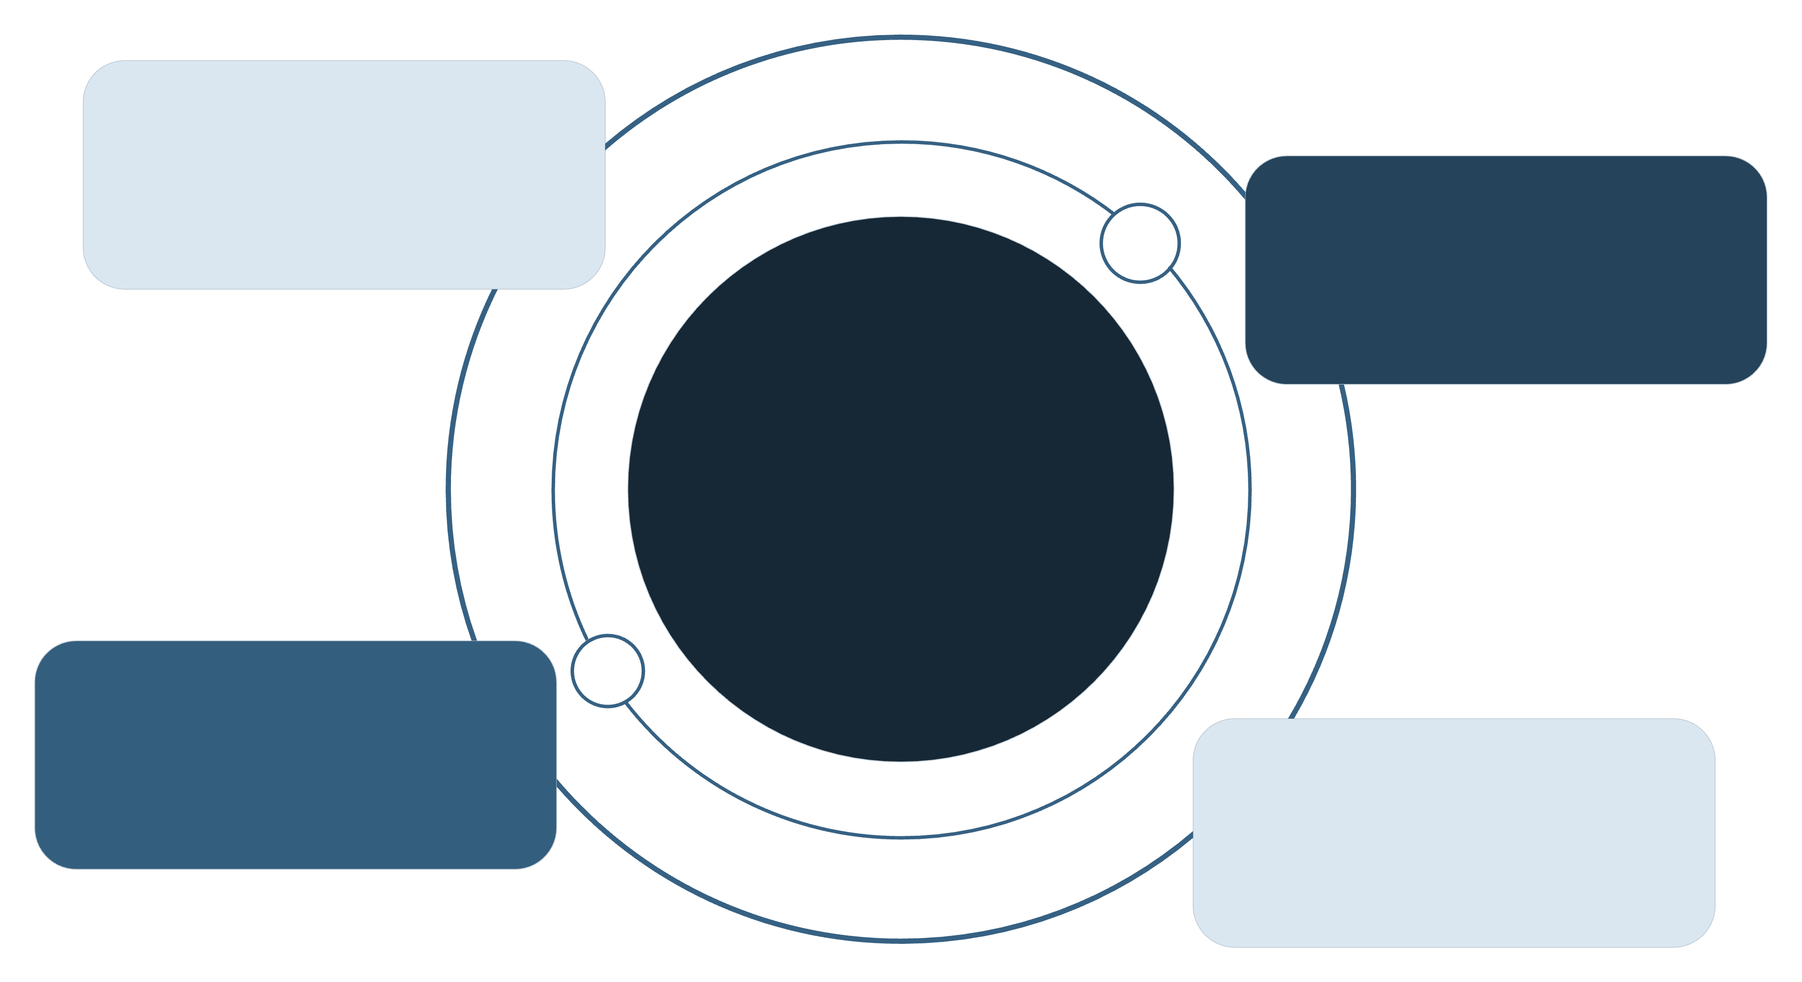





The Role of Advanced Technologies in Healthcare Services
By harnessing the world's most advanced technologies, AMETAZ GROUP has elevated its healthcare services to a new level of sophistication. Key technologies leveraged include:
Deep Learning
Computer vision for diagnostics
Natural Language
Clinical notes and insights
Healthcare Outcomes
Improved diagnosis, care, and efficiency
Reinforcement Learning
Personalized treatment policies
Medical IoT
Remote monitoring and sensors
Deep Learning & Computer Vision
Natural Language Processing (NLP) in Medicine
Reinforcement Learning in Medicine
Tumor Detection: Utilizing Convolutional Neural Networks (CNNs) to accurately identify tumors in CT scans, MRIs, and pathology slides.
Medical Record Analysis: Extracting key information from physician reports, test results, and clinical notes.
Treatment Optimization: Developing systems that can learn optimal treatment strategies for specific patients.
Medical Image Analysis: Extracting subtle features from radiological images that are invisible to the human eye.
Clinical Question Answering: Developing systems that can answer medical questions based on scientific evidence.
Hospital Resource Management: Optimizing the allocation of resources like beds, equipment, and staff to increase efficiency.
Automated Classification: Automatically classifying medical images based on disease type and severity.
Automated Summarization: Creating automatic summaries of lengthy medical histories for faster decision-making.
Disease Progression Prediction: Modeling disease progression and predicting clinical outcomes based on different interventions.
Medical Internet of Things (IoT)
Computational Genomics & Bioinformatics
Real-Time Patient Monitoring: Using smart sensors for continuous monitoring of patient vital signs.
DNA Sequence Analysis: Using advanced algorithms to analyze genomic data and identify mutations associated with diseases.
Smart Drug Delivery: Developing drug delivery systems that can intelligently adjust dosage and timing.
Drug Response Prediction: Developing models that can predict which patients will respond best to which drugs.
Intelligent Hospital Environments: Creating smart rooms that can adjust environmental conditions based on patient status.
Novel Therapeutic Target Discovery: Identifying new molecular targets for drug development using genomic and proteomic data analysis.

Slide 8








Core Competencies and Distinctive Capabilities
The success of AMETAZ GROUP in delivering superior healthcare services is attributable to a unique amalgamation of specialized team expertise spanning medicine, artificial intelligence, and technology:
Medicine & Medical Technology
Artificial Intelligence & Machine Learning
Expertise in medical technologies and advanced diagnostic devices.
Mastery of advanced deep learning and computer vision algorithms.
Experience in developing and clinically validating AI-powered medical systems.
Experience in developing AI-powered diagnostic systems based on medical images.
Proficiency in designing clinical studies and evaluating the efficacy of diagnostic systems.
Expertise in optimizing AI models for clinical applications.
Medical Software Engineering
Data Science & Bioinformatics
Expertise in developing medical software in compliance with regulatory standards.
Deep knowledge of genomic, proteomic, and metabolomic data analysis.
Experience in designing scalable, secure systems for health data.
Experience in developing predictive models for chronic diseases.
Proficiency in integrating AI systems with hospital IT infrastructure.
Proficiency in integrating multi-source data for complex analyses.
Clinical Research & Epidemiology
Digital Health Transformation Project Management
Expertise in designing and managing clinical trials for validating AI systems.
Experience in managing complex digital transformation projects in medical organizations.
Experience in analyzing epidemiological data and identifying disease patterns.
Proficiency in coordinating multidisciplinary and international teams.
Proficiency in evaluating the effectiveness of medical interventions in large populations.
Cybersecurity & Health Data Privacy
Ethics & AI Governance in Medicine
Deep knowledge of security challenges in medical systems.
Deep understanding of ethical challenges in using AI in medicine.
Experience in implementing privacy-preserving techniques in health data analysis.
Experience in developing governance frameworks for medical AI systems.
Expertise in designing systems resilient to cyberattacks.
Proficiency in designing fair and unbiased systems.

Slide 9
Strategic Advantages of Collaboration & Commitment to Responsible Health Innovation
Strategic Advantages of Collaboration
A Commitment to Responsible Health Innovation
Partnering with AMETAZ GROUP in the healthcare sector offers numerous strategic advantages, providing access to multidisciplinary expertise that combines a unique blend of medical knowledge, artificial intelligence, and technological proficiency to deliver comprehensive and integrated solutions.
AMETAZ GROUP views healthcare not merely as an industry but as a catalyst for creating a positive societal impact and increasing equitable access to healthcare services. This commitment is manifested in three principal domains:
The group's commitment to developing systems with clinically proven accuracy and efficacy, validated in reputable studies, generates tangible and meaningful results for patients. A focus on solutions that improve the quality of care while simultaneously reducing operational costs, optimizing resources, and increasing efficiency ensures enhanced value.
Global Health & Equitable Access
Developing cost-effective solutions for underserved regions, supporting healthcare projects in developing countries, and promoting equitable access to diagnostic and therapeutic technologies.
Expertise in international regulations and quality standards facilitates market entry, while continuous advisory, educational, and post-implementation support services guarantee the long-term success of organizations. A commitment to continuous innovation through the application of the latest technologies and methodologies empowers organizations to achieve competitive leadership. The development of fair, transparent, and responsible AI systems that benefit all patients reinforces the ethical and responsible dimension of the collaboration.
Ethics in Medical AI
Developing fair and unbiased systems for all demographic groups, transparency in algorithmic performance and system decisions, and upholding patient privacy and protecting sensitive data.

Slide 10
Conclusion
In today's complex healthcare landscape, organizational success hinges on the ability to embrace new technologies, uphold clinical standards, and maintain a commitment to professional ethics. With a profound understanding of this necessity, AMETAZ GROUP positions itself as the strategic partner of choice for medical organizations on their digital health transformation journey.
Precision
Human-centricity
Prevention
Developing diagnostic and predictive systems with the highest possible accuracy
Designing solutions that empower clinicians while preserving their decision-making authority
Focusing on predicting and preventing diseases rather than merely treating them
Personalization
Ethics
Delivering customized solutions for each patient based on their unique profile
A commitment to developing fair, transparent, and responsible systems
Collaborating with AMETAZ GROUP enables medical organizations to achieve unprecedented diagnostic accuracy and reduce medical errors, identify diseases at early stages and prevent their progression, deliver personalized treatment plans that enhance therapeutic efficacy, reduce operational costs and increase clinical efficiency, and position themselves at the vanguard of the digital health revolution, securing market leadership. The confluence of unique team expertise, international experience, and a relentless commitment to continuous innovation establishes AMETAZ GROUP as the trusted partner for organizations seeking long-term success in the healthcare revolution.
"At AMETAZ GROUP, we perceive healthcare not merely as a science, but as the art of blending artificial intelligence with human compassion; an intelligent, precise, and human-centric system that restores hope and makes health attainable for all."

