Slide 1
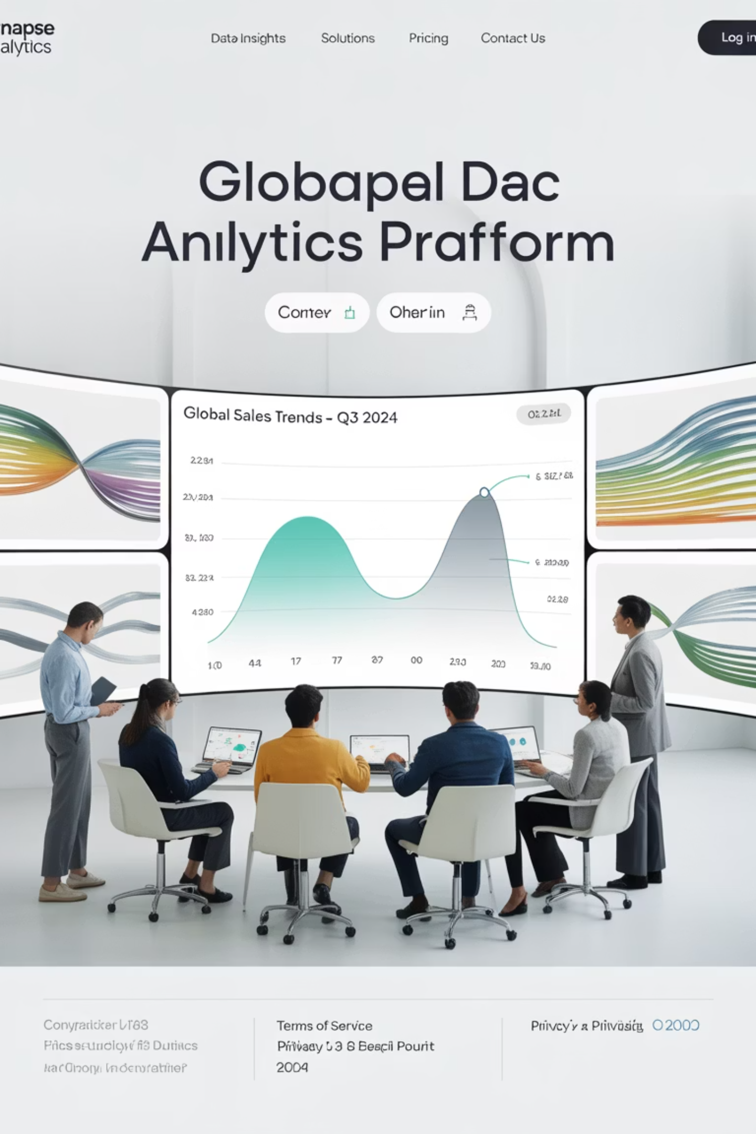

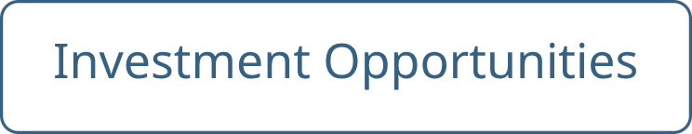
AMETAZ GROUP
Orchestrating Global Transformation Through Strategic Integration, Technological Prowess, and Unwavering Vision
In an era defined by unprecedented volatility, rapid technological acceleration, and an urgent global call for sustainable progress, AMETAZ GROUP has positioned itself as a vanguard of transformation—a catalyst for meaningful, enduring change across the world's most critical industries.

Slide 2






Our Dynamic Ecosystem
We are not a conglomerate in the conventional sense, nor are we a simple consultancy. AMETAZ GROUP is a dynamic ecosystem of expertise, a global network of visionary thinkers, seasoned practitioners, and technological innovators united by a singular, powerful purpose: to architect a future where progress is synonymous with sustainability, where technological advancement serves humanity, and where strategic investment fosters global prosperity.
Technological Mastery
Our work seamlessly weaves together cutting-edge AI, financial engineering, medical science, and sustainable energy solutions.
Strategic Foresight
We don't just adapt to the future; we actively design and construct it, partnering with organizations to unlock their potential.
Human-Centric Impact
We believe that true innovation is born not from isolated genius but from the synthesis of diverse perspectives.
Our identity is forged in the crucible of multidisciplinary collaboration, where the lines between sectors blur to give rise to integrated solutions that address the core needs of our time.

Slide 3
Artificial Intelligence & Information Technology
The Digital Nervous System of the Modern Enterprise
In the contemporary business arena, Information Technology and Artificial Intelligence have transcended their roles as mere support functions to become the central nervous system of any successful, resilient organization. They are the bedrock of operational agility, the engine of data-driven decision-making, and the primary differentiator in an increasingly competitive global market.
Strategic Digital Consulting
Cloud & Modern Infrastructure
AI & Machine Learning Solutions
We partner with leadership to craft a long-term digital vision, assessing digital maturity, identifying transformative opportunities, and designing meticulous digital roadmaps aligned with business goals.
We specialize in architecting next-generation IT infrastructures with seamless cloud migration strategies, resilient cloud architectures, container orchestration, and infrastructure as code.
Our practice develops bespoke systems including predictive models, recommendation engines, computer vision systems, and NLP solutions that learn, adapt, and drive intelligent outcomes.
The AMETAZ GROUP advantage in AI & IT lies in our ability to bridge the gap between deep technological expertise and pragmatic business application. We are not technologists for technology's sake; we are strategic partners who understand that the ultimate goal of any IT initiative is to drive growth, enhance resilience, and create tangible value.

Slide 4
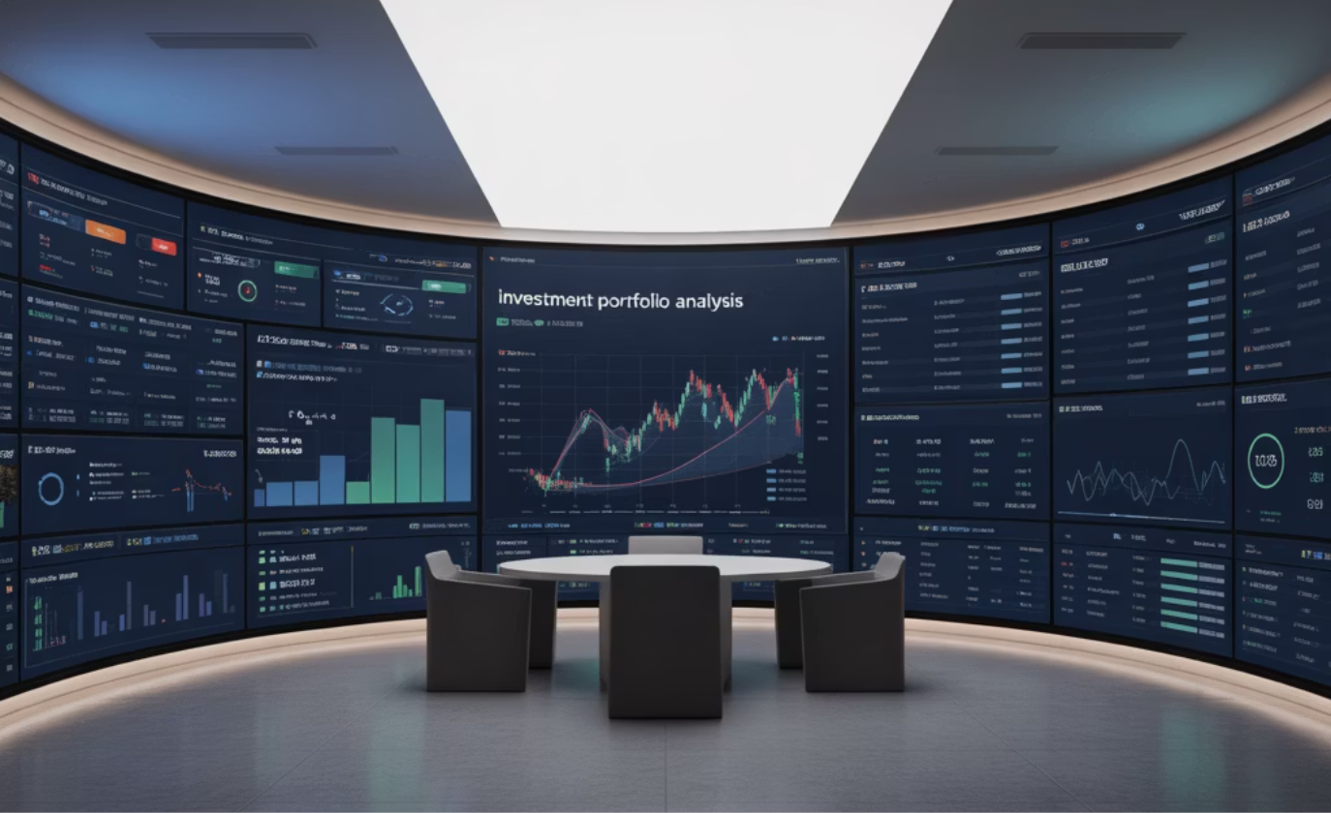
Capital Management
Engineering Financial Resilience and Strategic Growth
Capital is the lifeblood of any organization, but in today's volatile global economy, its effective management is a complex and high-stakes discipline. It is no longer sufficient to simply balance the books; true financial leadership requires a strategic, forward-looking approach that can navigate market uncertainties, optimize capital structure, and unlock new avenues for growth.
Our methodology is built upon a synthesis of quantitative rigor and strategic foresight. We empower our partners to move beyond reactive financial management and adopt a proactive stance, turning their capital structure into a formidable competitive weapon.
Data-Driven Analytics & AI
Multi-Objective Optimization
Leveraging advanced analytics and artificial intelligence to extract actionable insights from complex financial data.
Balancing competing financial objectives to achieve optimal capital allocation and utilization.
Integrated Risk Management
Transparent Monitoring & Reporting
Comprehensive approach to identifying, measuring, and mitigating financial risks across the organization.
Clear, actionable financial intelligence delivered through intuitive dashboards and reports.
The AMETAZ GROUP approach to Capital Management is distinguished by its seamless integration of Responsible Investment principles. We believe that long-term value creation is inextricably linked to environmental, social, and governance (ESG) factors.

Slide 5
International Business Consulting
Architecting Global Footprints and Navigating Cross-Border Complexity
Globalization is no longer a choice but an imperative for survival and growth in the 21st century. However, expanding beyond domestic borders introduces a labyrinth of cultural, regulatory, geopolitical, and operational complexities that can overwhelm even the most seasoned organizations.
Market Entry Strategy & Global Expansion
Global Supply Chain Management & Logistics
International Finance & Tax Management
We design the blueprint for successful international growth through granular analysis of target markets, crafting tailored market entry strategies, and developing detailed execution plans that mitigate risk and maximize success.
We engineer supply chains that are not just efficient, but also resilient and agile, optimizing end-to-end global logistics networks that can withstand disruptions while delivering operational excellence.
We navigate the intricate web of global finance with sophisticated currency risk management, optimization of global financial structures, strategic international tax planning, and expert management of cross-border cash flows.
AMETAZ GROUP distinguishes itself through a profound commitment to Responsible Global Commerce. We believe that international business should be a force for good, actualized through our dedication to Responsible & Ethical Trade, Local Development & Community Empowerment, and Environmental Sustainability in Global Operations.

Slide 6
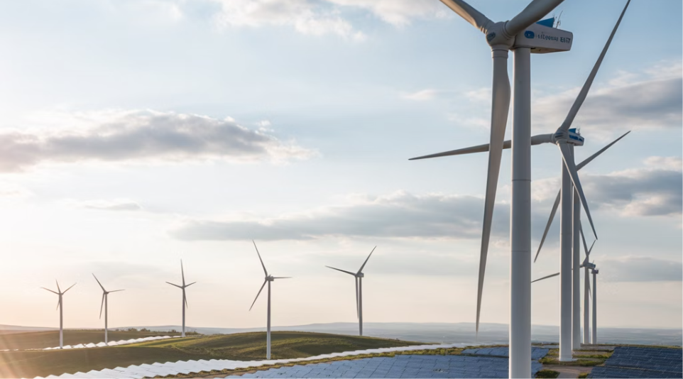
Energy
Powering a Sustainable Future Through Technological Innovation
The global energy sector is at a historic inflection point, caught between the undeniable imperative of decarbonization and the persistent demand for reliable, affordable power. The transition to a sustainable energy future is the defining challenge—and opportunity—of our time.
Our approach is holistic and pragmatic, grounded in a deep understanding of both traditional energy markets and cutting-edge clean technologies. We see the energy transition not as a burden, but as the greatest economic and environmental opportunity of the 21st century.
Renewable Energy & Hybrid Systems
Green Hydrogen & Clean Energy Carriers
We design and deploy clean power plants that seamlessly integrate multiple renewable sources with advanced energy storage solutions, creating resilient, reliable, and economically viable power ecosystems.
We are pioneering the development of the hydrogen economy, offering services spanning the entire value chain from production to utilization across various industrial sectors.
1
2
3
Smart Grids & Energy Infrastructure
We build the intelligent backbone for the modern energy landscape, implementing smart grids that dynamically manage supply and demand, integrate distributed energy resources, and self-heal.
Our commitment extends beyond technology to a profound sense of Environmental Stewardship and Social Responsibility. We champion Energy Equity & Global Access, ensuring that the benefits of clean energy are shared by all.

Slide 7



Healthcare
Redefining Medicine with Artificial Intelligence and Human-Centric Innovation
The healthcare industry is undergoing a profound metamorphosis, driven by the convergence of biological sciences, digital technology, and a new focus on personalized, preventative care. The traditional model of reactive, symptom-based medicine is giving way to a future of predictive, personalized, and participatory health.
AI-Powered Medical Imaging
Disease Risk Prediction
Personalized Medicine
We analyze EHRs, genomics, and lifestyle factors to identify individuals at high risk for chronic diseases long before symptoms appear, enabling proactive, preventative interventions.
We use AI to analyze a patient's unique genetic, molecular, and clinical profile to predict their response to specific drugs, optimize dosages, and design bespoke treatment plans.
Our systems identify tumors, fractures, and other subtle anomalies with a speed and accuracy that augments the capabilities of radiologists and pathologists, leading to earlier and more accurate diagnoses.
Our work in healthcare is underpinned by an unwavering commitment to Ethics and Equity. We are dedicated to Global Health & Equitable Access, striving to ensure that our innovations benefit all segments of society. We adhere to the highest standards of Ethics in Medical AI, developing systems that are fair, transparent, and free from bias.

Slide 8
Investment Readiness
Bridging the Chasm Between Innovation and Capital
In the dynamic landscape of global finance, innovation without capital is merely an idea, and capital without innovation yields suboptimal returns. For startups, growth-stage companies, and large-scale projects alike, navigating the complex process of securing the right kind of funding, from the right partners, on the right terms, is a critical and often daunting challenge.
Valuation & Value Enhancement
Strategic Organizational Preparation
We identify and implement strategic initiatives to increase organizational value prior to seeking investment.
We assess and enhance organizational readiness for investment, ensuring all aspects from governance to operations are optimized to attract capital.
Networking & Investor Introductions
Customized Funding Strategy
We leverage our extensive global network to connect organizations with the right investors for their specific situation.
We design tailored approaches to capital raising based on organizational stage, sector, and specific needs.
The AMETAZ GROUP approach to investment is guided by a philosophy of Responsible and Impactful Investing. We are committed to promoting investments that generate not only strong financial returns but also create a positive social and environmental footprint.

Slide 9

The AMETAZ GROUP Synthesis
Where Synergy Creates Superior Outcomes
The true power of AMETAZ GROUP lies not in the excellence of any single pillar, but in the profound synergy between them. We are uniquely positioned to address the most complex, multifaceted challenges of our time because we see the connections that others miss.
AI & IT
International Biz
Healthcare
Investment Readiness
Capital Mgmt
Energy
We understand that a global expansion strategy (Pillar III) is underpinned by robust IT infrastructure (Pillar I). We recognize that a breakthrough in personalized medicine (Pillar V) requires massive capital investment (Pillar VI) and is powered by immense computational energy (Pillar IV). We know that building a sustainable energy future (Pillar IV) is itself a major investment opportunity (Pillar VI) that requires astute financial management (Pillar II).
This integrated perspective is our signature. It allows us to offer our partners a level of strategic coherence that is simply unattainable through specialized, siloed firms. When you engage with AMETAZ GROUP, you are not hiring a consultant, an IT firm, or an investment bank. You are gaining a partner with a 360-degree view of your business and its place in the world.

Slide 10
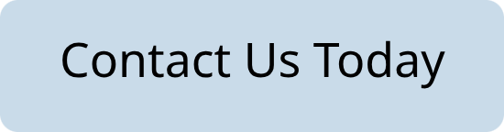
Contact AMETAZ GROUP
Phone & Email
Office Locations
Main Office: +49 (0) 30 1234 5678
Berlin HQ: Unter den Linden 123, 10117 Berlin, Germany
Investor Relations: +49 (0) 30 8765 4321
Istanbul: Bağdat Caddesi 456, 34710 Istanbul, Turkey
General Inquiries: contact@ametazgroup.com
Social Media
Investment Opportunities: invest@ametazgroup.com
Follow us on LinkedIn, Twitter, and Facebook for the latest updates on our innovations and opportunities.
Our vision is clear and our commitment is unwavering. We are dedicated to leading globally, succeeding strategically, and innovating relentlessly across multiple sectors to drive sustainable growth and create a meaningful, lasting impact worldwide.

