Slide 1
Magic Realism

Slide 2
Definition
A literary movement associated with a style of writing or technique that incorporates magical or supernatural events into realistic narrative without questioning the improbability of these events.
“Literary Movements for Students”
A literary genre or style associated especially with Latin America that incorporates fantastic or mythical elements into otherwise realistic fiction.
“Webster’s Dictionary”

Slide 3
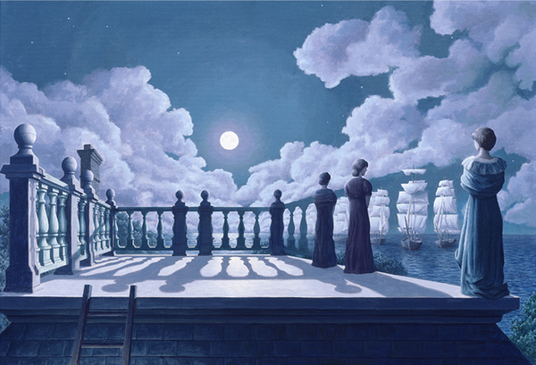
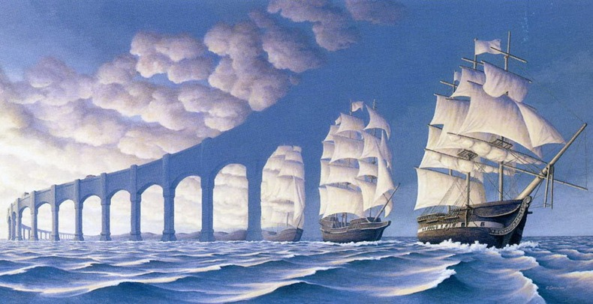
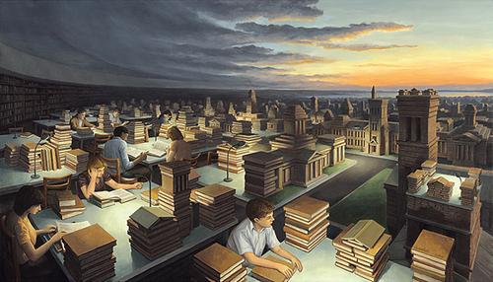
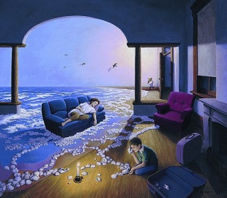

Slide 4
Background
Began around 1924, when a German art critic, Franz Roh, used the term to describe real forms which were painted in a way that did not coincide with reality.
Term evolved to apply to Latin American writers in the 1940s whose works “was a way to express the realistic American mentality and create an autonomous style of literature” at the same time.

Slide 5
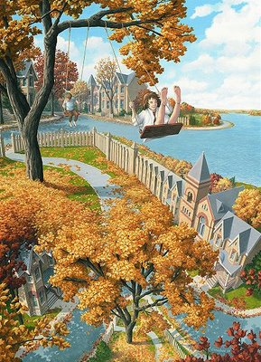
In Magic Realism
Events don't follow our expectations of “if/then”, like most novels.
“If this happens, then this will follow.”
Things often happen without an explanation, or for reasons that we don't expect.

Slide 6
Elements of Magical Realism
Transformation of the common and the everyday into the awesome and the unreal.
Elements of dreams, fairy story, or mythology combine with the everyday.
The frame or surface of the work may be conventionally realistic.
Have a strong narrative drive.
Fantastic elements are never explained and characters never question the fantastic element
Union of opposites (life and death, etc.)

Slide 7
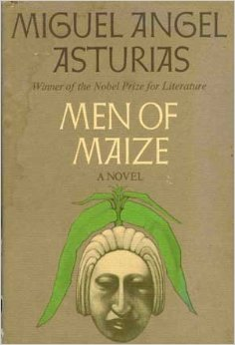
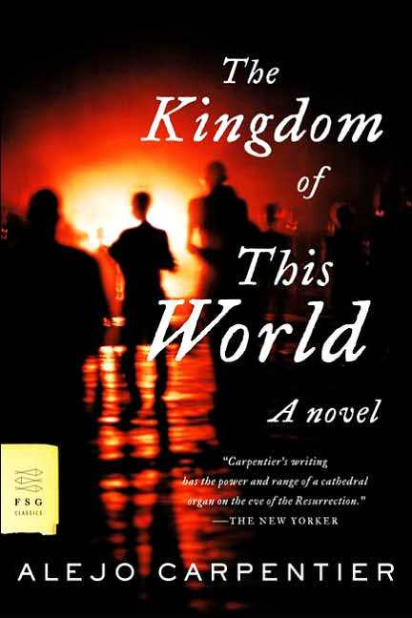
The movement is generally claimed to have begun in the 1940s with the publication of two important novels: Men of Maize by Guatemalan writer Miguel Angel Asturias and The Kingdom of This World by Cuban writer Alejo Carpentier.

Slide 8
Representative Authors
Isabel Allende (1942–)
Miguel A ´ ngel Asturias (1899–1974)
Jorge Luis Borges (1899–1986)
Mikhail Bulgakov (1891–1940)
Alejo Carpentier (1904–1980)
Laura Esquivel (1950–)
Carlos Fuentes (1928–2012)
Gabriel Garcia Marquez (1928–2014)

Slide 9
Marquez on Magic Realism
Garcia Marquez maintains that realism is a kind of premeditated literature that offers too static and exclusive a vision of reality. However good or bad they may be, they are books which finish on the last page. Disproportion is part of our reality too. Our reality is in itself all out of proportion. In other words, Garcia Marquez suggests that the magic text is, paradoxically, more realistic than the realist text.

Slide 10
Surrealism

Slide 11
Dictionary Meaning
A 20th century style and movement in art and literature in which images and events that are not connected are put together in a strange or impossible way, like a dream, to try to express what is happening deep in the mind.
“Oxford Dictionary”
the principles, ideals, or practice of producing fantastic or incongruous imagery or effects in art, literature, film, or theater by means of unnatural or irrational juxtapositions and combinations. “Webster Dictionary”

Slide 12
Definition
A style of art and literature developed principally in the 20th century in Europe, in which fantastic visual imagery from the subconscious mind is used with no intention of making the artwork logically comprehensible.
Surrealism developed out of the Dada activities of World War I and founded in 1924 by poet and critic Andre Breton who published The Surrealist Manifesto.
Influenced by theories of Sigmund Freud
Surrealism was not only an art movement, but a philosophy that embraced literature, music, cinema, and popular culture.
The word itself was invented by the French poet Guillaume Apolinaire.

Slide 13
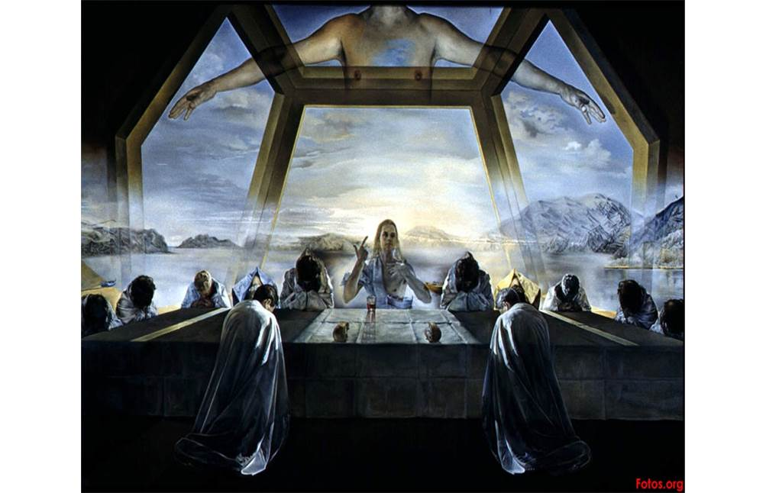
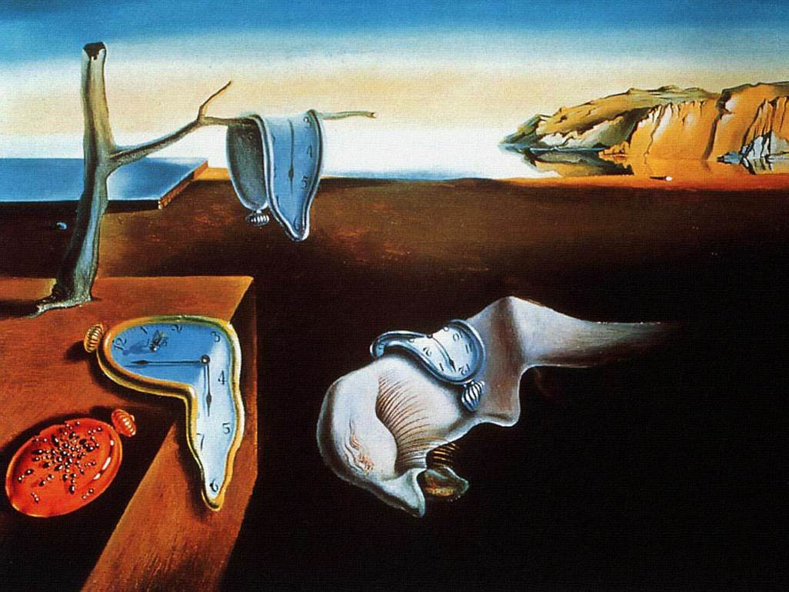

Slide 14
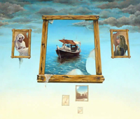
"A dream that is not interpreted is like a letter that is not opened"
In general, the style focuses on psychological states which resemble dreams and fantasy.

Slide 15
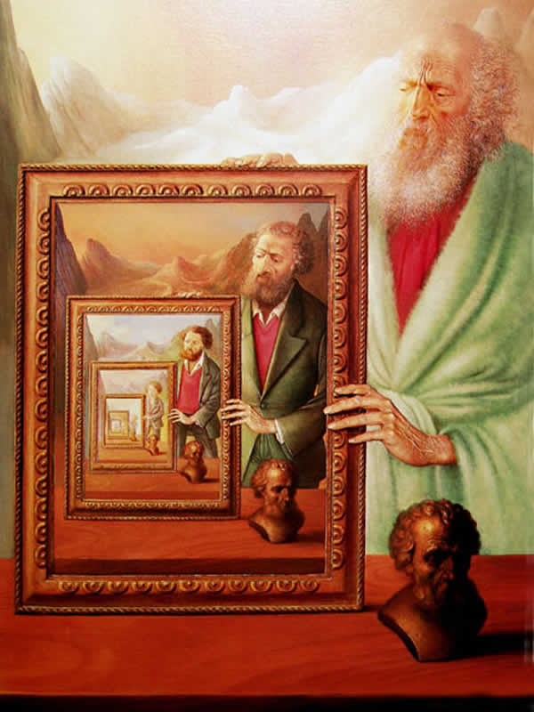
The word "surreal", in fact, means "above reality". In other words, the artists believed that there was an element of truth which is revealed by our subconscious minds which supersedes the reality of our everyday consciousness.

Slide 16
Representative Authors
Paul E ´ luard (1895–1952)
Pierre Reverdy (1889–1960)
Philippe Soupault (1897–1990)
Louis Aragon (1897–1982)
Andre´ Breton (1896–1966)
Rene´ Crevel (1900–1935)
Robert Desnos (1900–1945)

Slide 17
Themes
Love: One of the favorite themes of the French surrealists was love, particularly the ability of love to overcome reason.
The Human Body: Surrealists were noted for their descriptions of the human body, particularly the female body.
Nature: The surrealists incorporate nature-related images in their poetry.

Slide 18
Style
Automatic Writing: surrealists used to try to obtain the most pure information, free from the bindings of rational thought. As Breton says “Put yourself in as passive, or receptive, a state of mind as you can”
Imagery: Poets use language in their works to create different kinds of images, in a literal or figurative manner.
Juxtaposition: the surrealists relied heavily on the positioning of their words to create the effects that they sought.

Slide 19
Movement Variations
Futurism: An artistic movement that developed in France, Italy, and Russia from 1908 through the 1920s and is an immediate precursor to Surrealism. Futurist theater and poetry abandoned traditional literary forms.
Surrealist Art
Surrealist Film
Surrealist Drama
England: Just as Breton did much to promote the surrealist movement in France, English poet and novelist David Gascoyne advanced the movement in the 1930s in England.

Slide 20
Nadiya Safarkhani

